Slide 1
Session Slides
Goals for Session
Agenda and Activities
Final Reflection

Slide 2
Session Goals
GOALS:
Share the work that you are doing on your own as you go through the course
Reflect on your learning
Practice some of the tools that you were introduced to in the course
Get to know others in your lab/class
STRUCTURE:
Will meet every two weeks for 1.5 hours
Large and small group discussions
Reflection activity at the end of each session
Notes:
Revise frequency and length of sessions based on your needs. Depending on whether this is going to be in person or online explain how you will conduct the discussions

Slide 3
Activities & Discussions

Slide 4
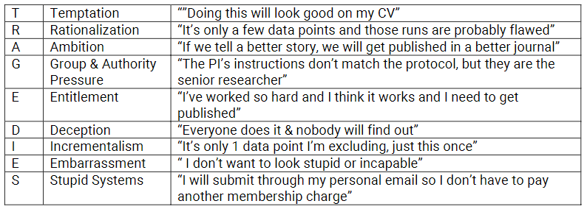
TRAGEDIES in the Lab
PROGRAM REFLECTION
TRAGEDIES
COMMUNICATION
In Scene 1.4, Dr. Heideberg directs Darren to put grad student Meena Anand in charge of the collaboration under Darren’s supervision to help remedy the delays in the collaboration. Take time to discuss the following questions (20 minutes):
Which elements of the TRAGEDIES do you observe in the scene?
Which systemic conditions in a lab make TRAGEDIES more likely to occur? Could the conditions be changed?
Notes:
Can go around and each group shares. You can also use chat or Pollev to have people share. You can also have everyone contribute their ideas to a Padlet.

Slide 5
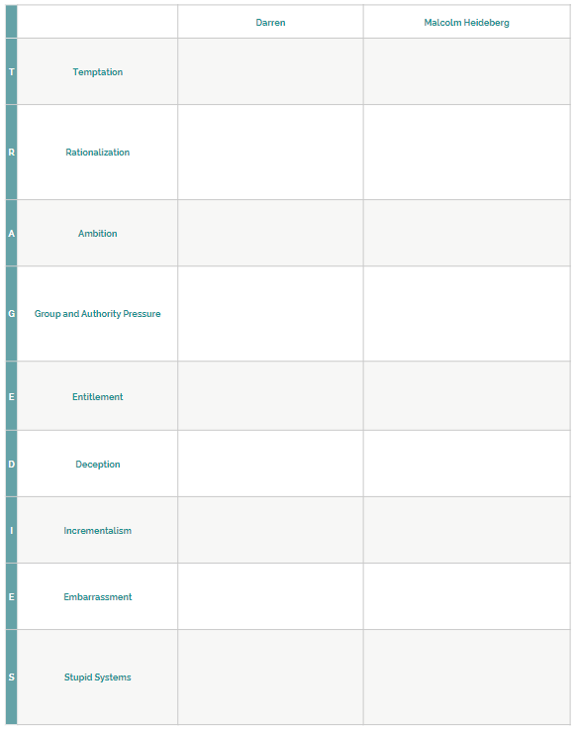
Avoiding Career TRAGEDIES
LOGBOOK ACTIVITY
TRAGEDIES
With your group, discuss the following (10-15 minutes):
Which elements of TRAGEDIES do you see?
Darren’s choices?
Heideburg’s choices?
Notes:
Can go around and each group shares. You can also use chat or Pollev to have people share. You can also have everyone contribute their ideas to a Padlet.

Slide 6
Better Sciene by Understanding TRAGEDIES
TRAGEDIES
BETTER SCIENCE
With your group, discuss the following question (10-15 minutes):
What are some reasons for delays in obtaining results in a lab, like in the scene?
Which ones can be solved by putting appropriate protocols and processes in place?
Which protocols and procedures are particularly useful when working with collaborators?
Notes:
As participants share their answers you can make a list in a google doc or have participants share their answers in a padlet

Slide 7
Lab Manual Discussion Questions
LAB MANUAL
For your discussion, remember that in this scene Dr. Heideberg directs Darren to put grad student Meena Anand in charge of the collaboration under Darren’s supervision to help remedy delays with the collaboration.
In small group Discuss the Following (10-15 Minutes):
What information would be helpful to include in the lab manual about how to assign projects in a lab? Where in the lab manual would you put that info?
Would if be helpful to have information that relates to working with collaborators in a lab manual? What information would be helpful and where would you include it?
Notes:
As participants share their answers you can make a list in a google doc or have participants share their answers in a padlet

