Slide 1
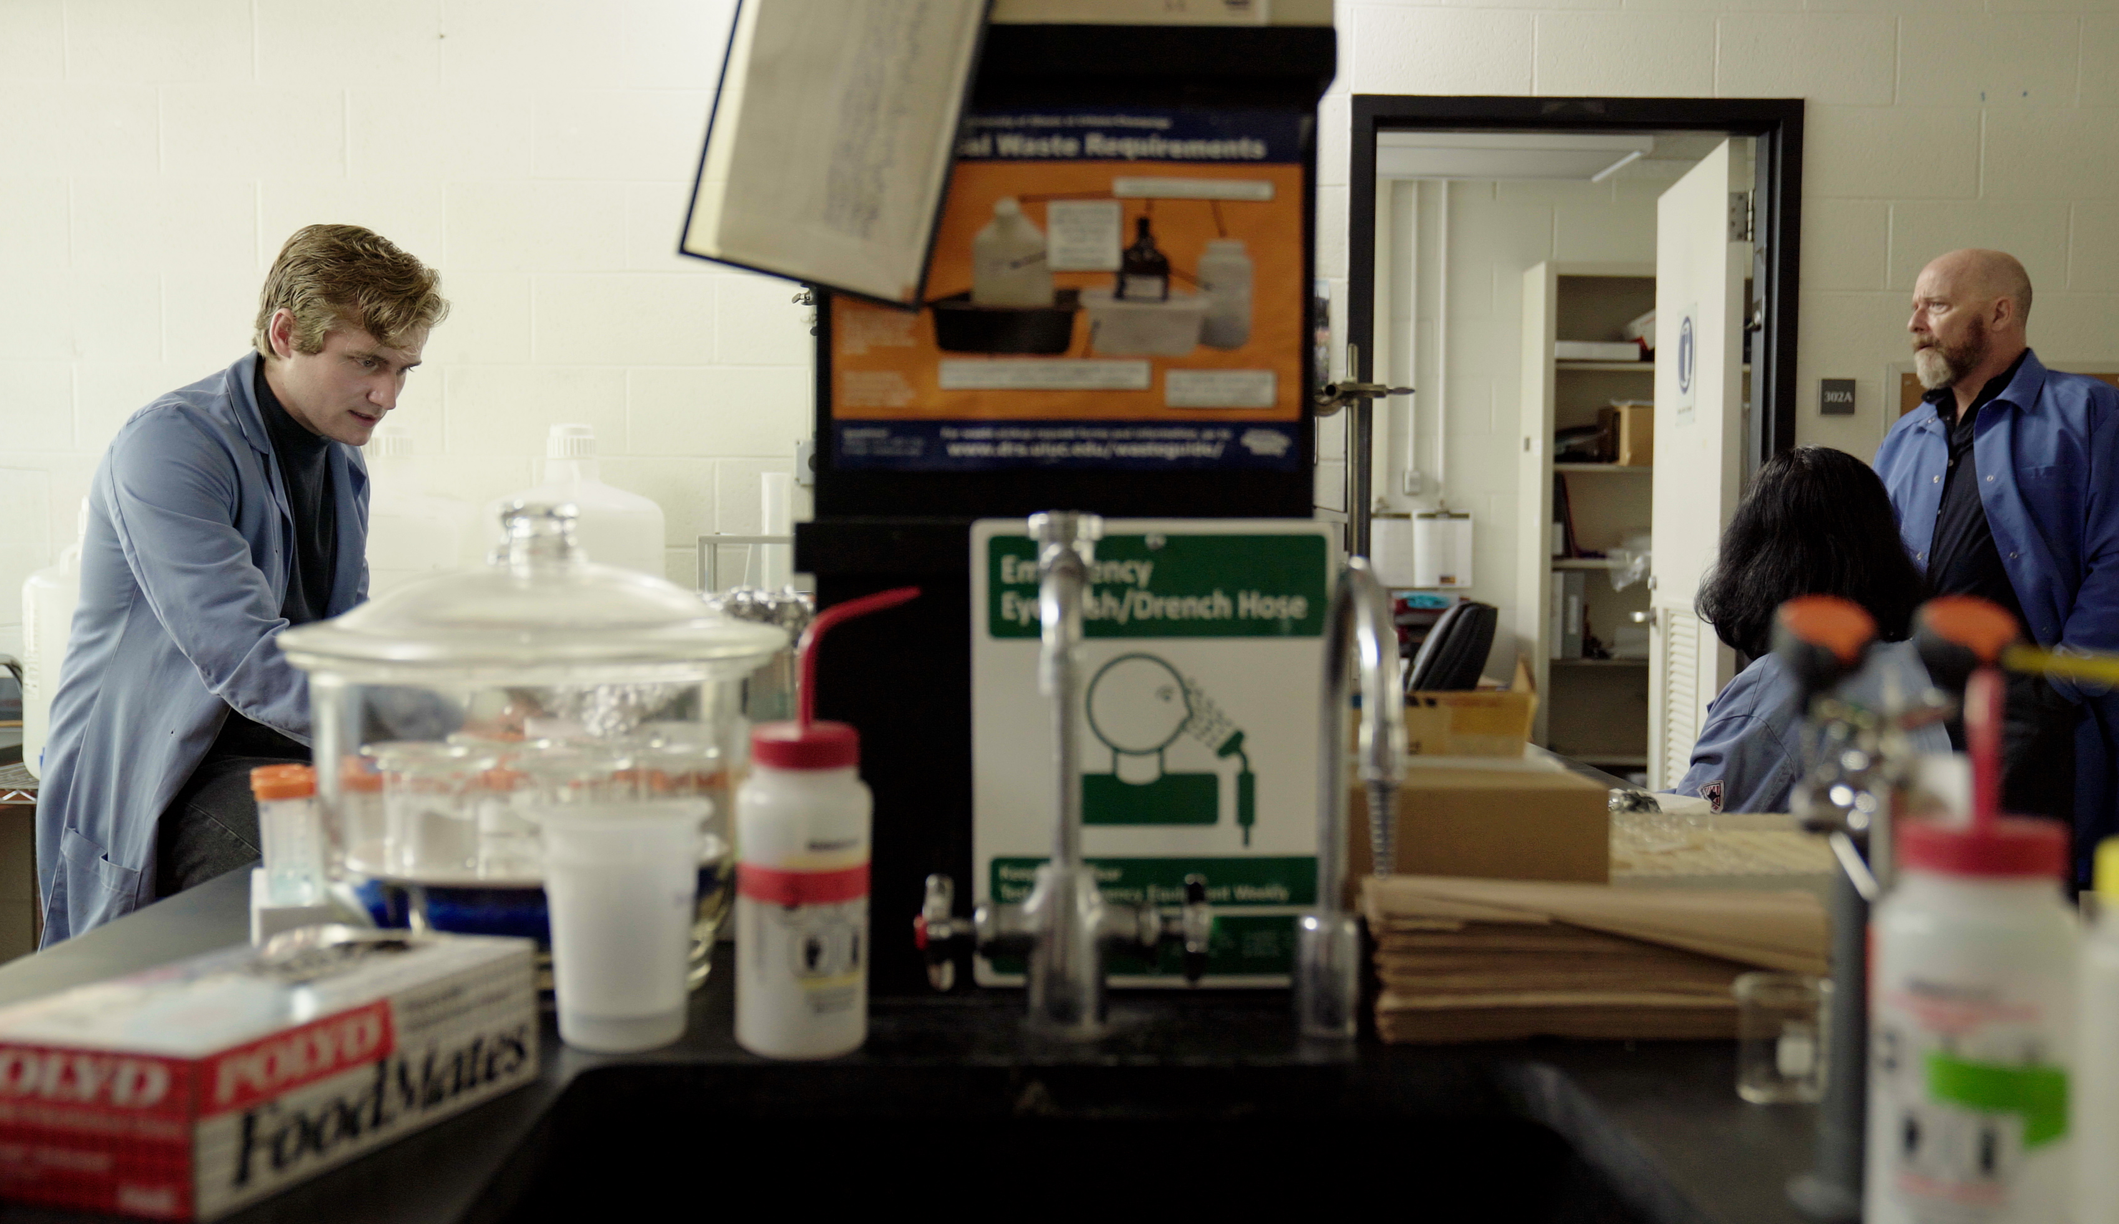
1.3 Facilitator Slides
Goals for Session
Agenda and Activities
Final Reflection
ncpre

Slide 2
1.3 Session Goals
GOALS:
Share the work that you are doing on your own as you go through the course
Reflect on your learning
Practice some of the tools that you were introduced to in the course
Get to know others in your lab/class
STRUCTURE:
Will meet every _ weeks for _ hours
Large and small group discussions
Reflection, Better Science, and Lab Manual questions can be part of each session

Slide 3
Activities and
Discussions
ncpre

Slide 4
Navigating Difficult Situations
In this Scene, Harold has recently joined the Heideberg lab. Harold is struggling with replicating Darren’s work and causing frustration to Heideberg and Darren.
Discuss the following questions in your small groups (5-10 Minutes):
How much of what Harold is encountering stems from his transition from his successful previous experience to a more competitive environment?
His first thought is that “it must be something” that he’s getting wrong. What factors and actions of those around him are contributing to his perception of the situation?
Ask one person to take notes for sharing with the larger group.

Slide 5
Navigating Difficult Situations
Share one or two key takeaways from your small group discussion with the whole group
(5-10 Minutes).

Slide 6
Decision Making Framework
The Decision Making Framework (DMF) is a 6-step tool to navigate difficult interactions and problem situations to assure that your choices are thoughtful, balanced, and contribute to positive outcomes.
Share with your group how you would you have applied the DMF to this episode.
Which of the 6 questions would be particularly helpful to Harold in this situation?

Slide 7
Decision Making Framework
Assign 1 person in your groups to record the main takeaways being shared in your discussion. Discuss the following 2MC, which is a real problem encountered by a researcher:
You began working in a new lab a few weeks ago. You met with your new PI in your first week to discuss the project you'd be working on, but you realize now you didn't ask as many—or the right—questions to really understand the work. After a few weeks of working, you do not have much to show for your time. You are supposed to present your work at next week's lab meeting, and you are afraid that, because you do not have much to show, your new PI will think you have not been working hard enough. You feel that it is too late to ask for additional direction or help because you have waited so long. You haven’t gotten to know any of your new colleagues well enough to feel comfortable asking them for advice, or whether any of them are doing work close enough to yours that you could ask for help. What do you do?

Slide 8
2 Minute Challenge (2MC) Debrief
Share one or two takeaways that you discussed with your group.
What are the exact words that you would use?

Slide 9
Better Science Discussion
In the scenario, Harold is having a hard time replicating the results of Darren’s work. Discuss the following questions as a group (10-15 Minutes):
What is the main reason for inconsistencies in experimental techniques? Differences in innate skill? Training?
What are the standards for training in experimental techniques? Should they be changed?
What kinds of things don’t typically get recorded, but should, while doing an experiment?

Slide 10
Lab Manual Discussion Questions
For your discussion, consider how in this Scene, Harold Wendling, a third-year grad student, is struggling with replicating Darren’s work synthesizing the compound used in the collaboration, much to Darren and Dr. Heideberg’s frustration.
In small group Discuss the Following (10-15 Minutes):
What information would be helpful to include in the lab manual about how to record and share experimental procedures and techniques with lab members?
What information should be included to prevent the situation that Harold is in? Where in the manual would you put it?

