Slide 1
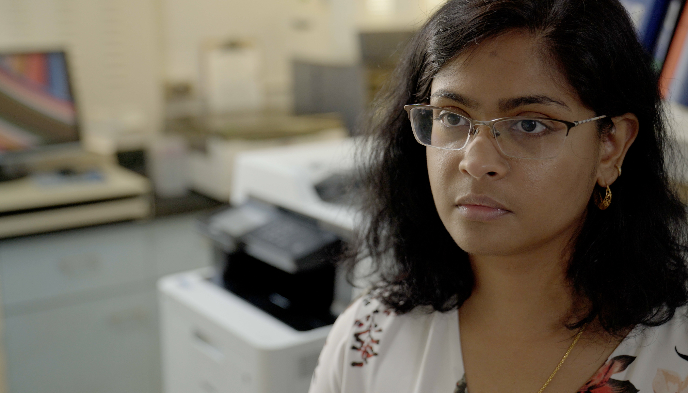
1.5 Facilitator Slides
Goals for Session
Agenda and Activities
Final Reflection
ncpre

Slide 2
1.3 Session Goals
GOALS:
Share the work that you are doing on your own as you go through the course
Reflect on your learning
Practice some of the tools that you were introduced to in the course
Get to know others in your lab/class
STRUCTURE:
Will meet every _ weeks for _ hours
Large and small group discussions
Reflection, Better Science, and Lab Manual questions can be part of each session

Slide 3
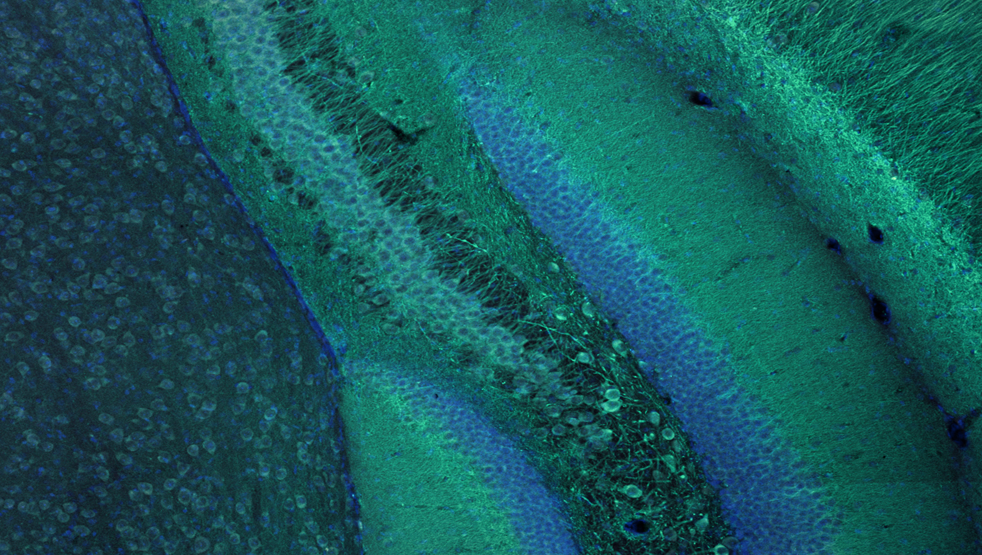
Activities and
Discussions
ncpre

Slide 4
When Experiments Fail
The interactions in this scene illustrate several lab leadership and power dynamics: Harold is not told directly by his adviser about his reassignment and is left to draw his own conclusions about what is happening and why. Meena is given no real options either to decline the project nor to decline being the one who informs Harold.
Discuss the following questions in your small groups (10-15 Minutes):
What is the difference between experiencing a failure and being a failure?
Think about Meena and Harold’s responses to not being able to make the compound. Can you identify any good or promising strategies?
Can you identify any strategies that could have been effective had they occurred in a different environment?
Ask one person to take notes for sharing with the larger group.

Slide 5
When Experiments Fail
Share one or two key takeaways from your small group discussion with the whole group (5-10 Minutes).
Discuss as a large group:
In an ideal lab, how would mistakes be handled such that lab members can learn and grow from the situation?

Slide 6
When Experiments Fail
The pursuit of science, like life more broadly, will contain moments of failure. If we are open and thoughtful, failure can teach us valuable lessons like what not to do, offer insight about how things relate/function, and provide clues about what could be attempted next.
The way you respond to failure, including the way you think about disappointment, the choices you make as you react, and the people and systems you use for support, make a difference in your well-being, self-esteem, professional productivity, and the way others see you.

Slide 7
When Experiments Fail
With your small group, discuss a situation in your career(s) where you experienced a failure. What were your thoughts and behaviors?
Write them down in a table, keeping them separate (10 Minutes):

Slide 8
Better Science Discussion
Key to the topic of this episode are the issues of reproducibility and replication.
Discuss the following questions (10-15 Minutes):
In an ideal lab, what should happen when someone cannot replicate a procedure in a lab notebook? What protocols should be in place?
What is the cost of not having these protocols in place?
What aspects of lab culture might hinder attempts at rigor and reproducibility?

Slide 9
Lab Manual Discussion Questions
Consider how at the center of this scene is the issue of handling failures to reproduce past results.
In small group Discuss the Following (10 Minutes):
What information should be included in the lab manual about how to report and handle the inability to replicate a process or results?
How will this improve communication within the lab? Between other labs?

