Slide 1
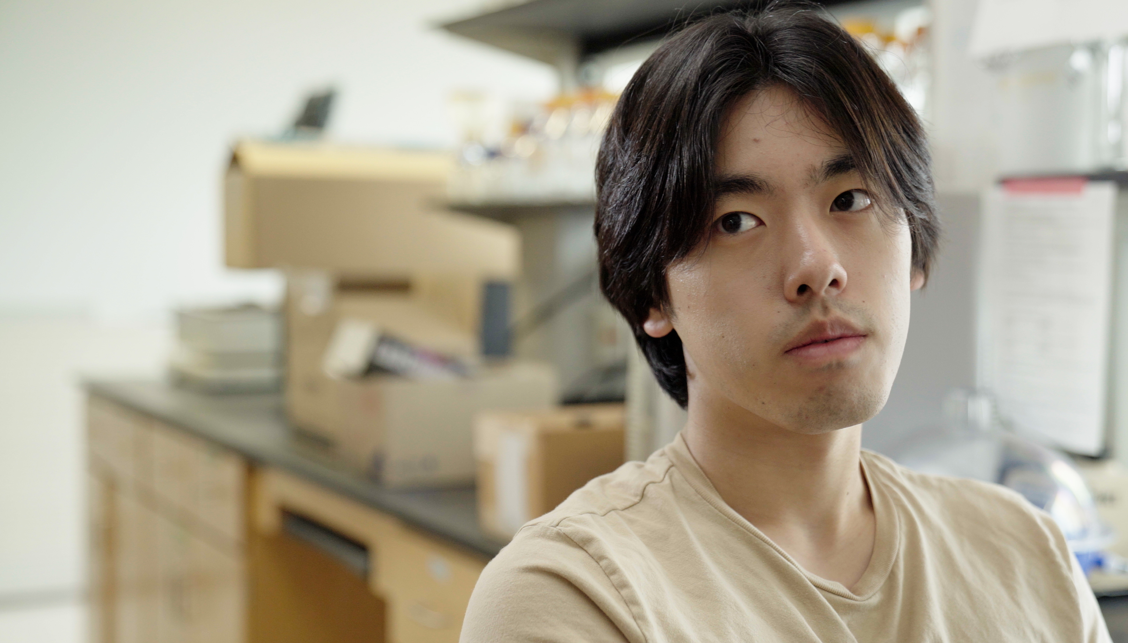
1.6 Facilitator Slides
Goals for Session
Agenda and Activities
Final Reflection
ncpre

Slide 2
1.6 Session Goals
GOALS:
Share the work that you are doing on your own as you go through the course
Reflect on your learning
Practice some of the tools that you were introduced to in the course
Get to know others in your lab/class
STRUCTURE:
Will meet every _ weeks for _ hours
Large and small group discussions
Reflection, Better Science, and Lab Manual questions can be part of each session

Slide 3
Activities and
Discussions
ncpre

Slide 4
Aligning to Solve Problems
The interactions in this episode center around resolving interpersonal communication issues and mentorship.
During their meeting, Sorenson equates her own experiences with sexism with what
Jayna is experiencing, saying “I've been there.”
Discuss the following questions in your small groups (10-15 Minutes):
Do you think that Jayna felt supported by Sorenson’s statements? Would you, in her place?
What are some ways in which Sorenson and Jayna’s experiences in science are likely to be different, based on what you know about them? How are they similar?

Slide 5
When Experiments Fail
Share one or two key takeaways from your small group discussion with the whole group (5-10 Minutes).
Discuss as a large group (5 Minutes):
With the previous questions in mind, what might you rather or additionally have seen in Sorenson’s interaction with Jayna?

Slide 6
Mentorship
During their meeting, Sorenson tells Jayna that, once she's a PI of her own lab, therewon't be anyone she can go to when she has questions/needs direction or guidance for making good decisions.
Discuss with your group (10 Minutes):
Do you think this kind of advice is helpful? Why or why not?
With the previous questions in mind, what do you think it would have been more helpful for Sorenson to say?
Share one or two key takeaways from your small group discussion with the whole group (5-10 Minutes).

Slide 7
And Stance
When you communicate in a difficult situation using the And Stance—by changing how you orient and align yourself in the conversation to solve problems rather than be in opposition to others—others will both attend longer to what you’re saying and retain more of it.
Rewatch the 1.5 Video with your group and listen for how characters in the scenes use “and” and “but” in their interactions with each other.
Write out phrases that they used and include changes using the And Stance to improve them.

Slide 8
And Stance Debrief
Share one or two findings with the larger group (5-10 Minutes).
Discuss with the larger group how using the And Stance doesn’t change the basic answer that you are giving; only the way in which you are saying it.

Slide 9
Better Science Discussion
The episodes so far have centered around issues of inconsistencies in lab results. In addition to the questions you have discussed already. Discuss the following questions (10-15 Minutes):
How should replication be built into the work of a lab?
Should there be a process of replication as a matter of course, rather than waiting for issues to be discovered? In other words, should replication be considered a part of a lab's usual quality control?
What are the pros and cons for building in replication protocols and what would those look like?

Slide 10
Lab Manual Discussion Questions
For your discussion, consider how in this Scene, Jules Sorenson is acting as a mentor and advising members of her lab and resolving interpersonal issues.
In small group Discuss the Following (10 Minutes):
Should the lab manual contain any information on mentorship for lab members?
What information would be helpful to have?

