Slide 1
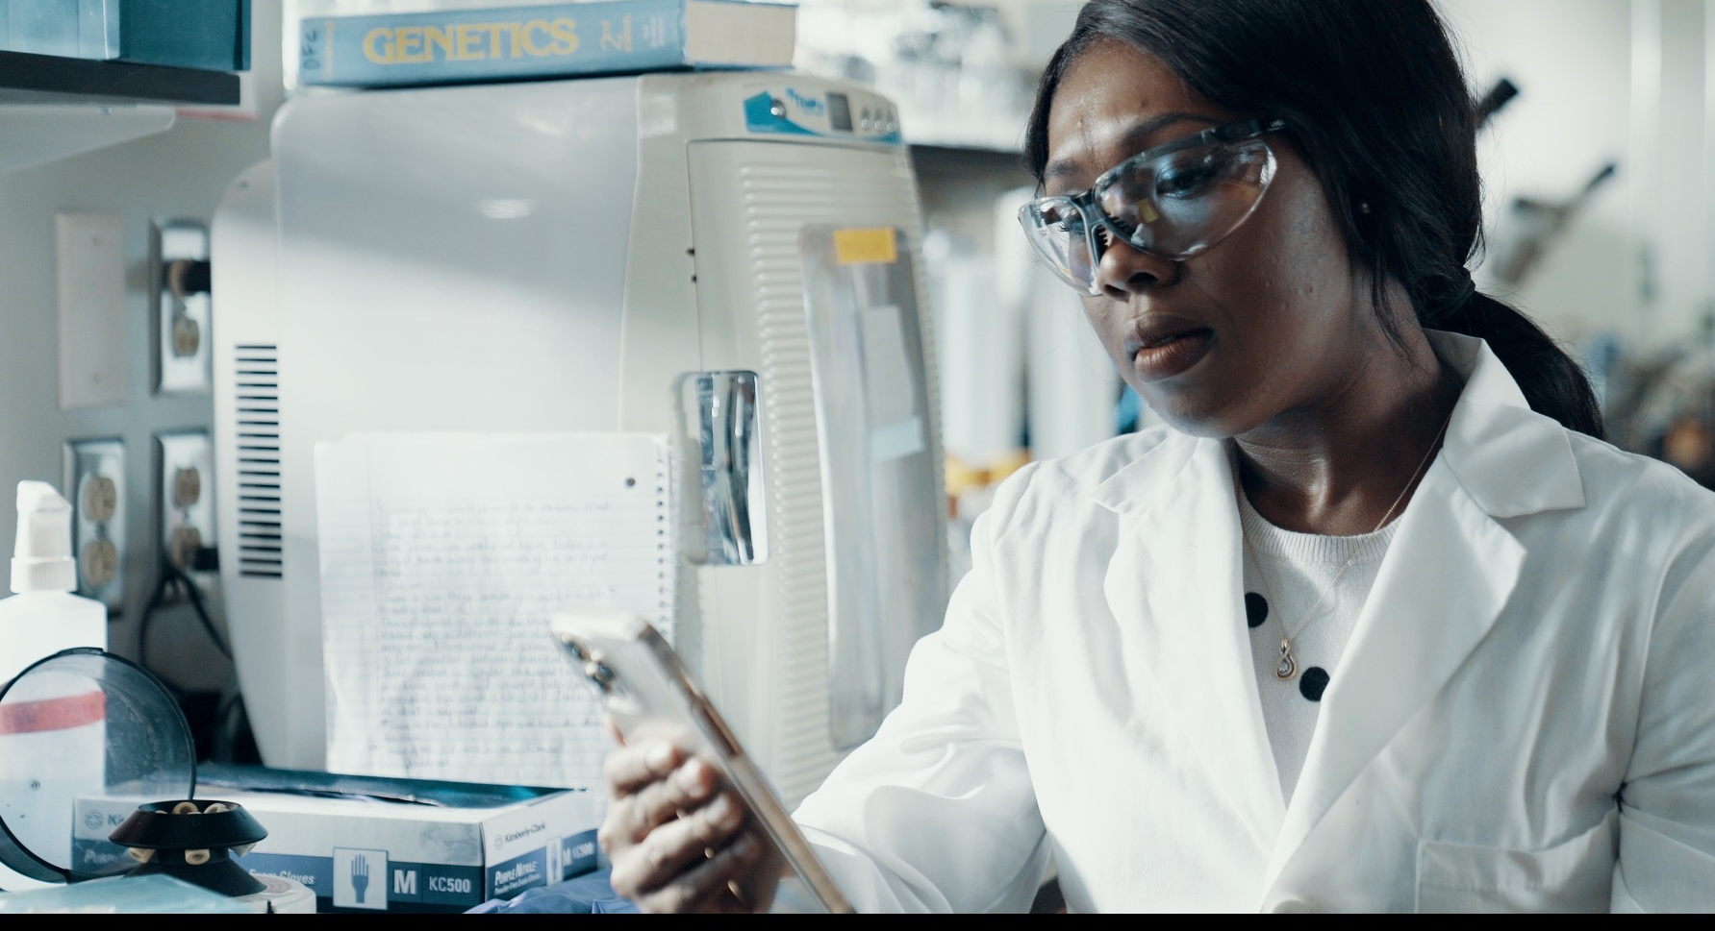
2.1 Facilitator Slides
Goals for Session
Agenda and Activities
Final Reflection
ncpre

Slide 2
2.1 Session Goals
GOALS:
Share the work that you are doing on your own as you go through the course
Reflect on your learning
Practice some of the tools that you were introduced to in the course
Get to know others in your lab/class
STRUCTURE:
Will meet every _ weeks for _ hours
Large and small group discussions
Reflection, Better Science, and Lab Manual questions can be part of each session

Slide 3
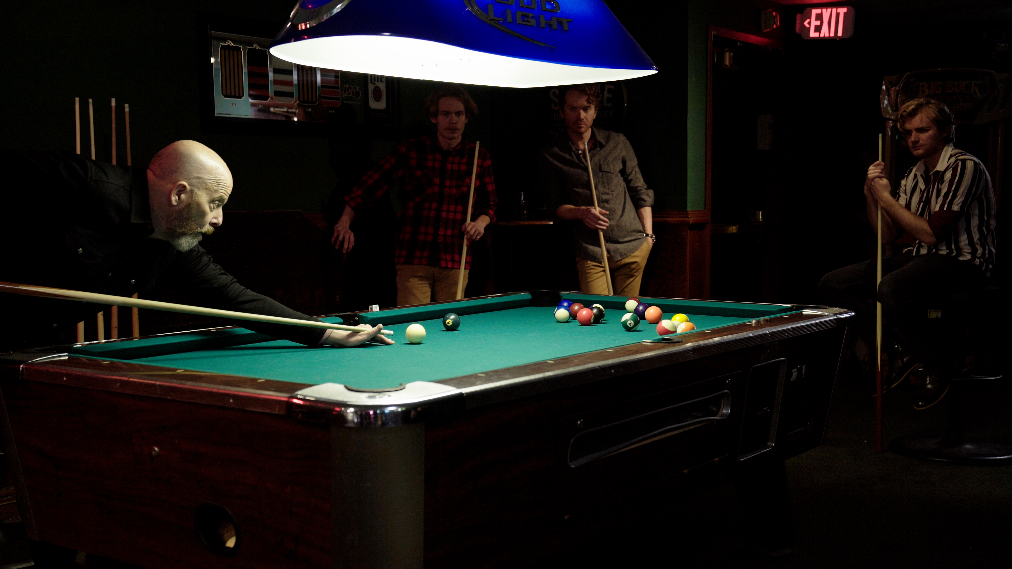
Activities and
Discussions
ncpre

Slide 4
Power and Bias
Bias that leads to in-grouping and out-grouping can exist in many different ways. In this scene, Meena is excluded from the World Cup/billiards event, and Harold is sidelined in the group. Bias can come from preferring those things that are most familiar to us, or preferring people who are most like us, though -- however inadvertently and without intent to do harm -- such biases can deny full inclusion, equal access and equal opportunity.
Discuss the following questions in your small groups (10-15 Minutes):
How can we manage the tension between intention and impact?
Bias doesn’t require hostility. Why does it often feel hostile?
Ask one person to take notes for sharing with the larger group.

Slide 5
Power and Bias
Share one or two key takeaways from your small group discussion with the whole group (5-10 Minutes).
Discuss as a large group:
Share the questions that you generated in the small group activity concerning mentorship and career guidance

Slide 6
Power and Bias
In a recent examination of students’ thoughts on mentor/mentee relationships, one student noted: “A key component to feeling confident about being a mentee is realizing that the relationship is symbiotic. This provides a frame to contribute to your mentor’s experience either through contributing to their work or promoting learning in terms of unknown knowledge. Recognizing the nature of the relationship makes me feel less guilty for seeking help as I now understand that it is a cycle that science development thrives on.”
Discuss the following questions in your small groups (10-15 Minutes):
In any one of your mentoring relationships, how clear are you on what you’re contributing to that mentor’s experience, and how clear are you on what they’re contributing to yours? Are her/his contributions meeting your needs?
How can each of the parties help sustain continuing mutual benefit?

Slide 7
Power on Display
How do power dynamics create or hinder cultures of inclusion and excellence? In your cohort discussion group, identify and explore the expressions of power in the scenes at the billiards/back in the lab (rewatch the scene if necessary) (15-20 Minutes)
What are the expressions of power on display? Identify and label at least three specific examples.
Are expressions of power contributing to the problems in the collaboration?
Are those expressions of power advancing or undermining the team in creating a more productive and inclusive environment?

Slide 8
Better Science Discussion
Power, bias, and inclusivity can directly affect the working environment of a workplace or lab.
Discuss the following questions (10-15 Minutes)
What are some of the ways in a science lab that some people may have more access to the lab head outside of the lab or in more informal settings?
What are some of the impacts on the science and career of individuals who have more or fewer opportunities for such informal access?

Slide 9
Lab Manual Discussion Questions
Consider how at the center of these scenes are issues of power, bias, and inclusivity, which may not always be included in the Lab Manual.
In small group Discuss the Following (10 Minutes):
What information would be helpful to include in the lab manual about addressing bias and inclusion?
Of the passages in the Sorenson and Heideberg lab manuals that you identified as particularly strong, what makes them so?
Are those approaches to addressing bias and inclusion as noted in the manual supported by practices in the lab?

