Slide 1
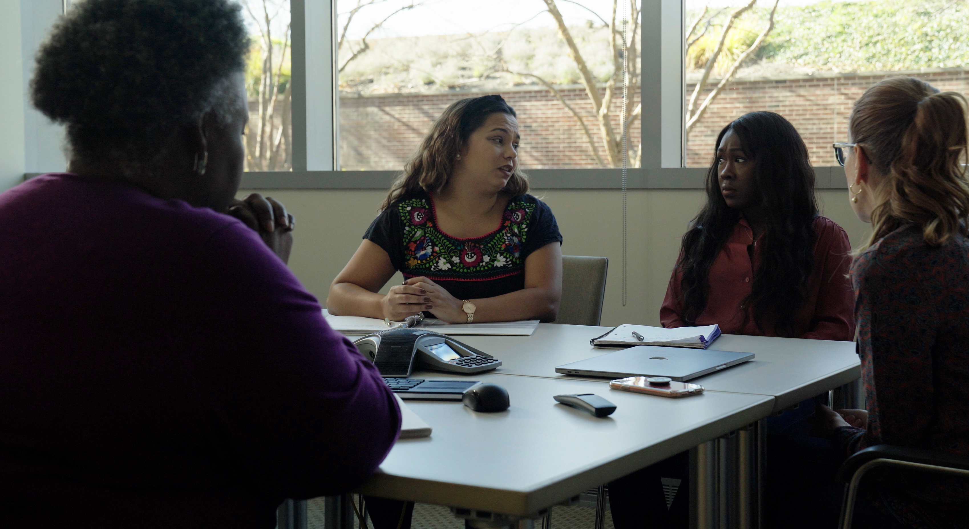
2.2 Facilitator Slides
Goals for Session
Agenda and Activities
Final Reflection
ncpre

Slide 2
2.2 Session Goals
GOALS:
Share the work that you are doing on your own as you go through the course
Reflect on your learning
Practice some of the tools that you were introduced to in the course
Get to know others in your lab/class
STRUCTURE:
Will meet every _ weeks for _ hours
Large and small group discussions
Reflection, Better Science, and Lab Manual questions can be part of each session

Slide 3
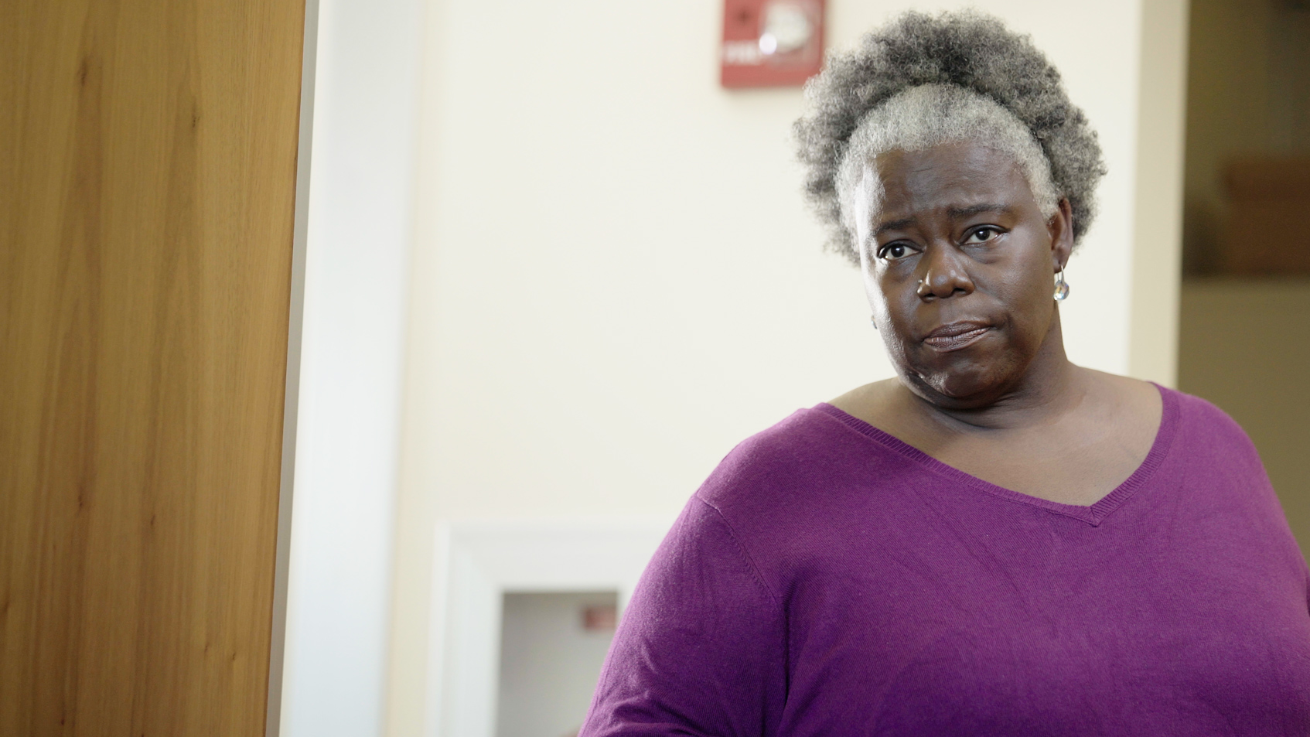
Activities and
Discussions
ncpre

Slide 4
Communication Large Group Discussion
Leaders set the tone by their actions and their words. How a leader frames information (is it an obstacle or a challenge to address?) and words difficult news matters. In scene 2.1 Jules deals with communicating unwelcome news to members of her lab.
Discuss the following questions in your small groups (10-15 Minutes):
How can a person's communication style be influenced/mitigated/constrained/freed by the mode of communication ( e.g., in-person, email, text, video, telephone)?
How can a person’s communication style be influenced by their own status or role and/or the status and role of the person to whom they are communicating?
Ask one person to take notes for sharing with the larger group.

Slide 5
Communication Large Group Discussion
Share one or two key takeaways from your small group discussion with the whole group (5-10 Minutes).
Discuss as a large group:
Share the questions that you generated in the small group activity concerning communication framing

Slide 6
Reframing Using the “And Stance”
Consider how much a change in framing and phrasing might have saved time and energy for starting this difficult conversation and moved more directly to aligning in problem-solving with Jayna.
With your small group, try out these reframed openings; use the And Stance to complete them (10 Minutes):
“Jayna, there’s a change in the Heideberg lab that is going to affect us, and....”
“Malcom Heideberg is responding to our concerns, and....”
“After some reflection, I think the news I just got presents us with an opportunity, and….”
“Here is what I think we agree on about the status of the collaboration, and….”

Slide 7
2-Minute Challenge – Drawing the Line
You’re relatively new to a lab and just getting comfortable with the people and rhythm of the group. Lab meetings have been focusing on problems reproducing one important line of work, and you’re wondering if something might be wrong with the cell lines they have been using for several years. In your last lab, there was a problem with incorrect cell lines, and it caused the same sorts of reproducibility issues being discussed in recent meetings. You’ve read the PLOS ONE paper estimating that nearly 33,000 articles in the literature are premised on incorrect cell lines. What should you do?
With a partner, apply the DMF to this scenario. Take 2 minutes to write down short answers to the following questions:
What issues does this situation present?
What rules and regulations apply?
What question do you need/want to ask?
What resources are available to you to work through this?
What options do you have? Who will be affected?
What are you going to do? Write down the exact words that you will use to begin the potentially difficult conversation.

Slide 8
2-Minute Challenge – Debrief
With the larger group, share and discuss your answers to the 2-Minute Challenge Scenario questions (10-15 minutes):
What issues does this situation present?
What rules and regulations apply?
What question do you need/want to ask?
What resources are available to you to work through this?
What options do you have? Who will be affected?
What are you going to do? Write down the exact words that you will use to begin the potentially difficult conversation.

Slide 9
Better Science Discussion
In this scene, the central topics of discussion were communication and mentorship from lab leaders, with a particular emphasis on access to leadership and training to become more competent at work tasks.
Discuss the following questions with your groups (10-15 Minutes):
What are the ways in which competence in the lab/at the bench can be realistically/appropriately assessed?
What are the ways in which competence in the lab/at the bench is often inappropriately assessed?
How might competence [or incompetence] in the lab/at the bench be presumed, across an array of contexts [postdoc, graduate student, man or woman, white or non-white]?

Slide 10
Lab Manual Discussion Questions
Consider how at the center of these scenes are issues of Mentorship and Communication.
In small groups, discuss the following (10 Minutes):
What information would be helpful to include in the lab manual about communication as it occurs in varying situational contexts and with different audiences?
Are there some key points about appropriate, respectful and inclusive communication that you would include?

