Slide 1
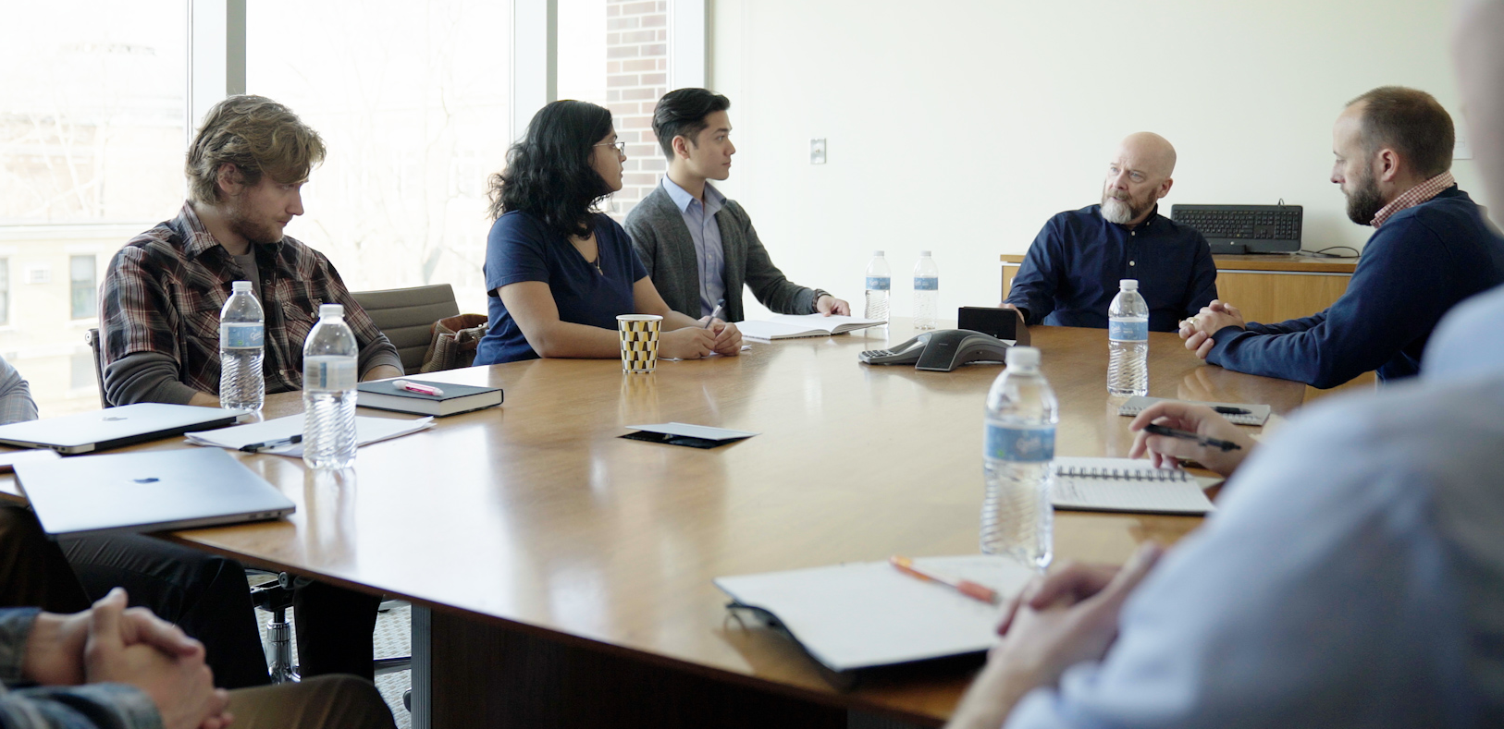
2.3 Facilitator Slides
Goals for Session
Agenda and Activities
Final Reflection
ncpre

Slide 2
2.3 Session Goals
GOALS:
Share the work that you are doing on your own as you go through the course
Reflect on your learning
Practice some of the tools that you were introduced to in the course
Get to know others in your lab/class
STRUCTURE:
Will meet every _ weeks for _ hours
Large and small group discussions
Logbook Activities, Program Reflection, Better Science, and Lab Manual questions can be part of each session

Slide 3
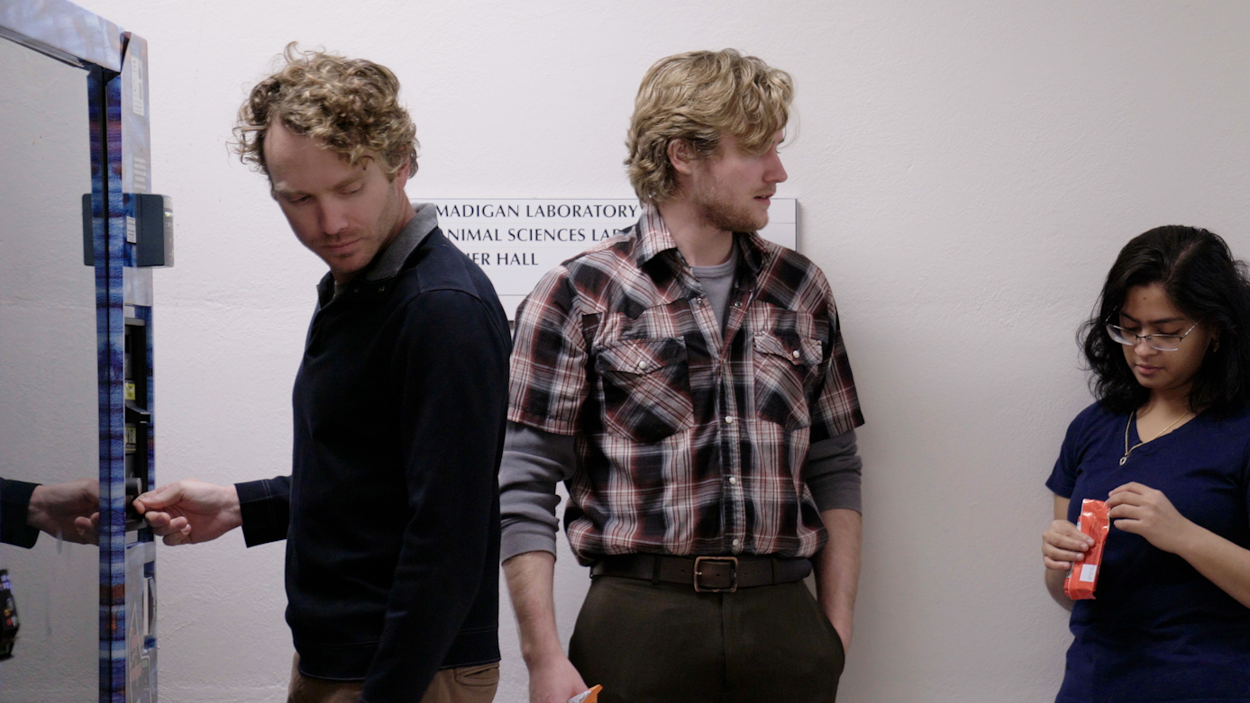
Activities and
Discussions
ncpre

Slide 4
Bystanding & Upstanding
An ‘upstander’ is someone who notices inappropriate or biased remarks and steps in to help in an awkward situation instead of just standing by—someone who “stands up” for their values and for others. Consider Meena’s situation and how it could have played out differently if any of her colleagues—or her lab head—had perceived and responded to how uncomfortable and inappropriate the interaction was.
Discuss the following questions in your small groups (10-15 Minutes):
●How might the idea of science as a meritocracy undermine both the assessment and rewarding of performance?
●What are some examples of specific barriers that women and people of color might face which contribute to an uneven playing field?
Ask one person to take notes for sharing with the larger group.

Slide 5
Bystanding & Upstanding
Large Group Discussion
Share one or two key takeaways from your small group discussion with the whole group (5-10 Minutes).
Discuss as a large group (5-10 Minutes):
●Share the questions that you generated in the small group activity concerning bystanding/upstanding/bias

Slide 6
Bystanding & Upstanding Part 2
Now take a few minutes to reflect on the scene from the point of view of Harold and what it means to strive for a culture of inclusion and respect.
Discuss and share your answers to these questions in your small groups (10 Minutes):
If Harold were a true ally for Meena, what might an appropriate and supportive response to Meena’s experience have been?
If Harold were to be an upstander, what might an appropriate response to Darren have been?

Slide 7
Practice and Share Scripts for Upstanding
It can be hard to find the right words in the moment, so it may help to think through how you might respond to different situations and have your personal scripts developed, ready, and practiced—as Ana Sofia did when responding to Alex in Episode 1.7.
With your small group, write down 2-3 personal scripts that you could use in the following situations (15 Minutes):
1.When you are in a situation where you are experiencing bias or incivility
2.When you are listening to someone else talk about a time when they experienced bias or incivility:
3.When you are a bystander and you observe someone who is experiencing bias or incivility:

Slide 8
Better Science Discussion
The topic of this section revolved around an incivility event that occurred at a lab poster meeting where the character Meena was presenting her research. Take some time with your group(s) to focus on the context of poster sessions and their role in the field.
Discuss the following questions with your groups (10-15 Minutes):
●In what ways are poster sessions valuable to your research or your career?
●What are some helpful things you can do in preparation of a poster session and/or during a poster session?
●How can a lab head help support a lab member who will be presenting at a poster session?

Slide 9
Lab Manual Discussion Questions
Consider how at the center of these scenes are issues of Upstanding and Bias.
In small groups, discuss the following (10 Minutes):
●Would you want to have a section in the lab manual about upstanding and bystanding?
●Would you include this in the communication section, or would you devote a distinct section to this issue?
●Would you want to add the examples of scripts provided in the workbook to the lab manual section on upstanding and bystanding?

