Slide 1
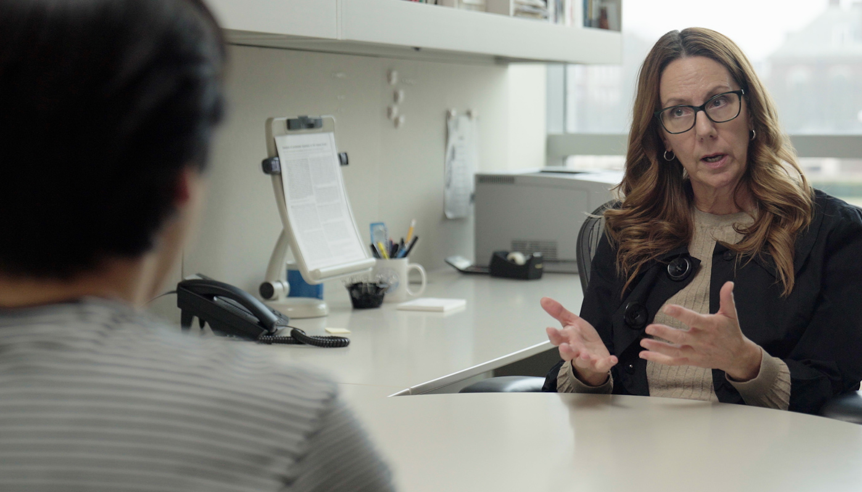
2.4 Facilitator Slides
Goals for Session
Agenda and Activities
Final Reflection
ncpre

Slide 2
2.4 Session Goals
GOALS:
Share the work that you are doing on your own as you go through the course
Reflect on your learning
Practice some of the tools that you were introduced to in the course
Get to know others in your lab/class
STRUCTURE:
Will meet every _ weeks for _ hours
Large and small group discussions
Reflection, Better Science, and Lab Manual questions can be part of each session

Slide 3
Activities and
Discussions
ncpre

Slide 4
Mentoring and Using Questions Effectively
According to research, effective mentors exhibit behaviors that include: (1) Aligning expectations; (2) Assessing understanding; (3) Communicating effectively; (4) Addressing equity and inclusion; (5) Fostering independence; and (6)Promoting professional development. A recent study¹ suggests that “quality four, addressing equity and inclusion.... should be used in developing a set of practices for the other five behaviors.”
Discuss the following questions in your small groups (10-15 Minutes):
How might addressing equity and inclusion impact the questions we ask our mentees? The was we listen to and hear their responses?
How might addressing equity and inclusion be used to: (1) align expectations? (2) communicate effectively?

Slide 5
Mentoring Large Group Discussion
Share one or two key takeaways from your small group discussion with the whole group (5-10 Minutes).
Discuss as a large group:
Share the questions that you generated in the small group activity concerning mentoring/using questions effectively

Slide 6
Mentorship
During their meeting, Sorenson tells Jayna that, once she's a PI of her own lab, therewon't be anyone she can go to when she has questions/needs direction or guidance for making good decisions.
Discuss with your group (10 Minutes):
Do you think this kind of advice is helpful? Why or why not?
With the previous questions in mind, what do you think it would have been more helpful for Sorenson to say?
Share one or two key takeaways from your small group discussion with the whole group (5-10 Minutes).

Slide 7
Using Questions Effectively
One of the most effective skills you can build is to ask good questions and deploy them effectively. For owning and managing your own career, questions can be a leadership skill to build. If you’re lower in power than the person with whom you’re dealing (as with a mentor), framing your questions to assist with problem-solving and as open-ended questions focused on learning and curiosity are skills to cultivate that can build trust.
In scene 2.4, how might Alex have told Jules that he needed a different kind of mentorship interaction or asked for specific help?
With your small group (5-10 minutes):
Write down 1-2 different personal scripts that Alex could have used in the situation
Share your ideas with the larger group (5-10 Minutes)

Slide 8
Better Science Discussion
The topic of this section revolved around mentorship in a lad setting where the P.I. and the graduate student weren’t properly communication with each other.
Discuss the following questions with your groups (10-15 Minutes):
When you consider your scientific career, what are the advantages and disadvantages of having more or less direction from your lab head?
How do you navigate the tension between learning to become an independent researcher versus being part of someone else's lab?
Does it change depending on your career stage and level of expertise?

Slide 9
Lab Manual Discussion Questions
Consider how at the center of these scenes are issues of Mentoring
In small groups, discuss the following (10 Minutes):
What is the one thing you would include in the lab manual about mentoring or mentoring meetings?
Share with your group the reason why you chose that one thing.

