Slide 1
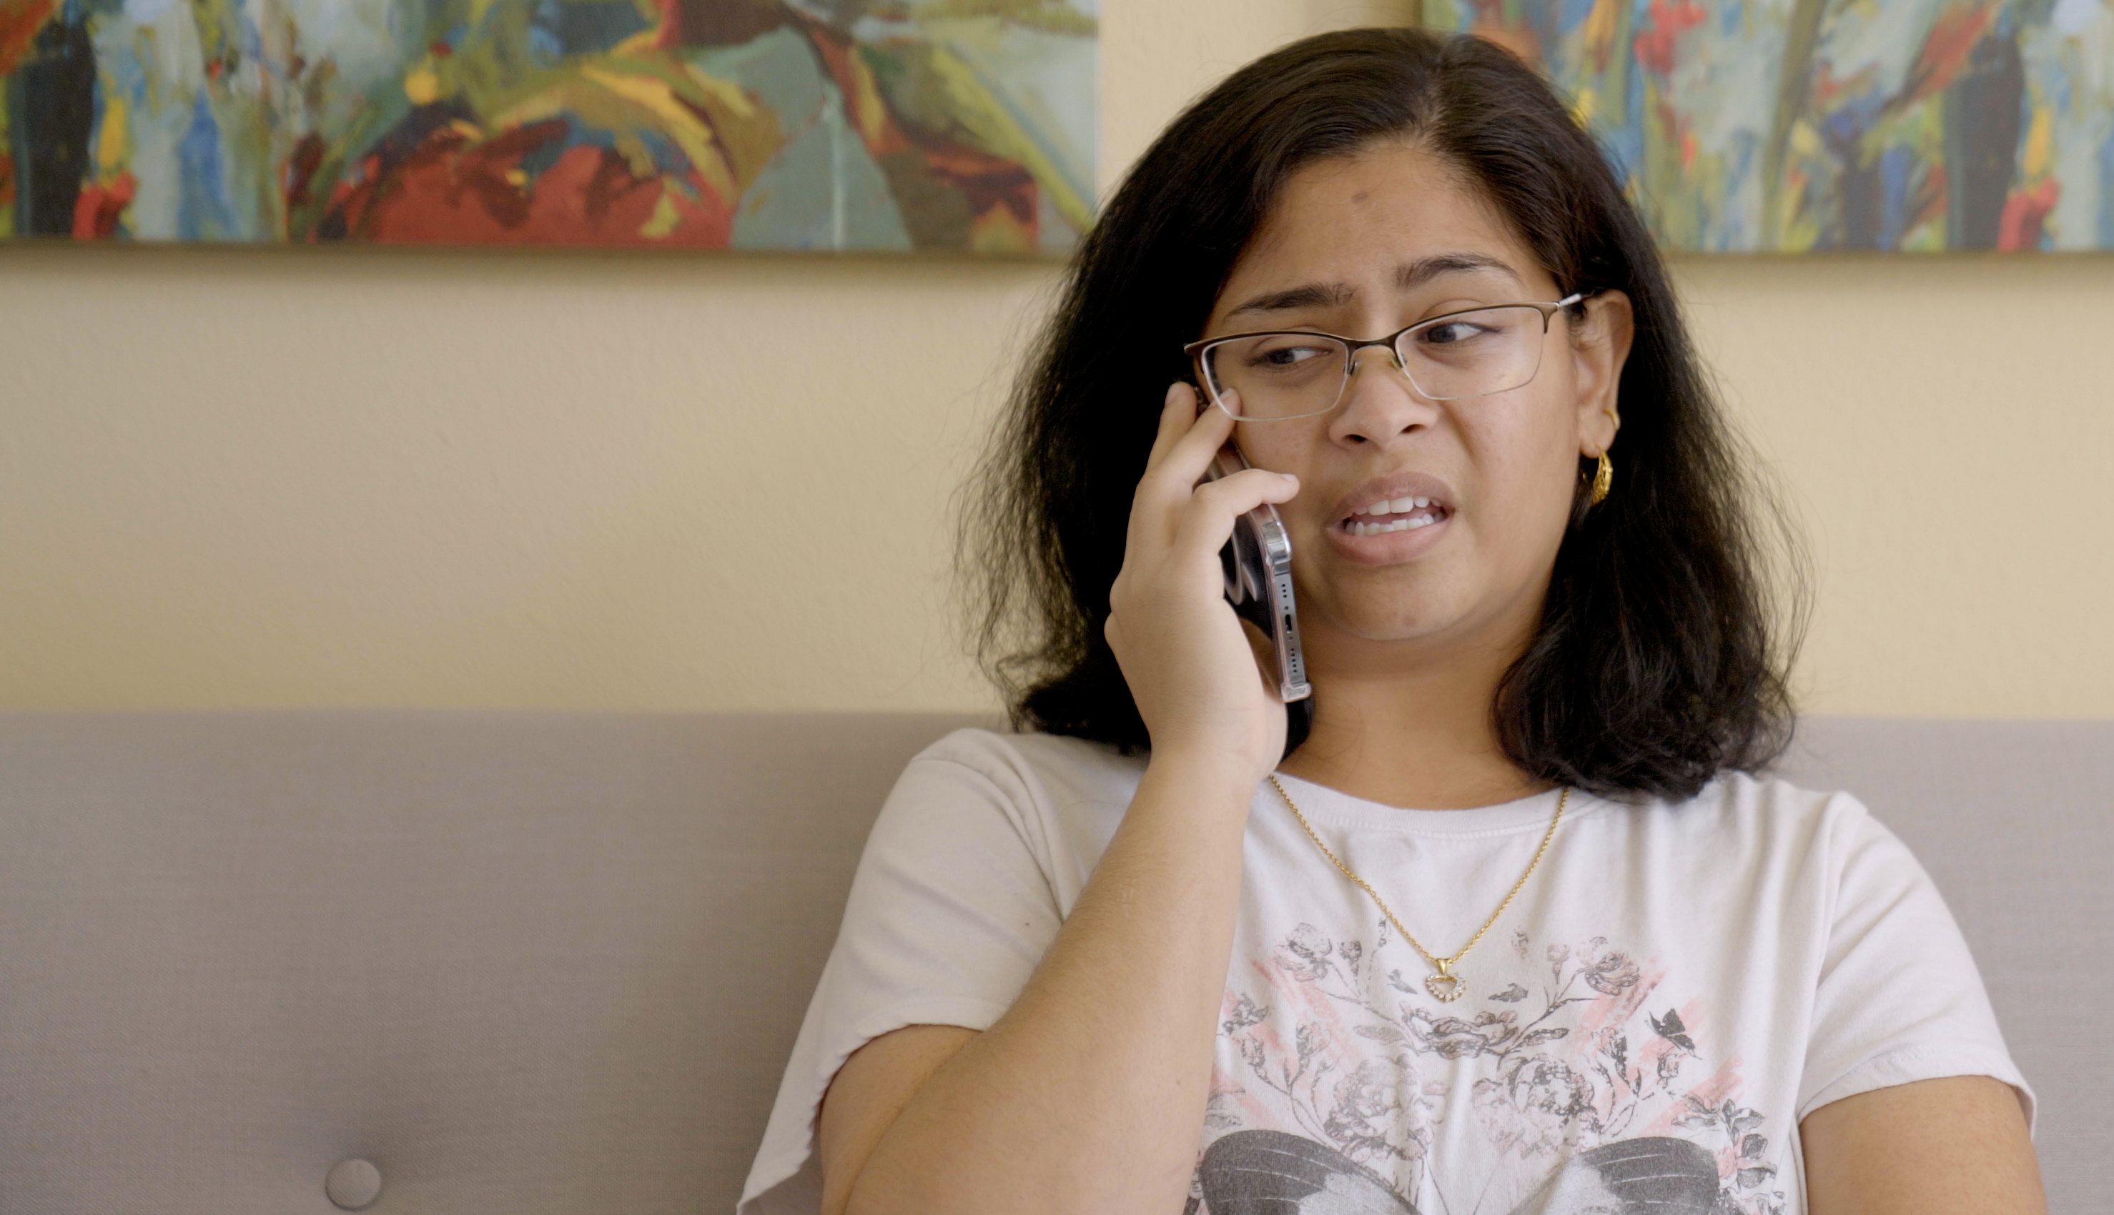
2.5 Facilitator Slides
Goals for Session
Agenda and Activities
Final Reflection
ncpre

Slide 2
2.5 Session Goals
GOALS:
Share the work that you are doing on your own as you go through the course
Reflect on your learning
Practice some of the tools that you were introduced to in the course
Get to know others in your lab/class
STRUCTURE:
Will meet every _ weeks for _ hours
Large and small group discussions
Reflection, Better Science, and Lab Manual questions can be part of each session

Slide 3
Activities and
Discussions
ncpre

Slide 4
Listening and Upstanding
Meena talks to Ana Sofia about her frustrations with the poster session. Ana Sofia listens and coaches Meena on personal scripts, helps her process the experience, and gives her resources going forward.
Discuss the following questions in your small groups (10-15 Minutes):
Now that you've used the Decision Making Framework in a couple of instances, which one of the six questions would be most useful to find an answer in a situation similar to Meena's?

Slide 5
Listening and Upstanding
Large Group Discussion
Share one or two key takeaways from your small group discussion with the whole group (5-10 Minutes).

Slide 6
Practice - Using the Personal Scripts
At a lab group meeting, a male postdoc argues with the PI about the interpretation of results. The PI thanks him for the rigorous scientific debate. Later in the meeting, a female postdoc brings up a point related to the interpretation issue. The PI responds, “that snarky attitude must be PMS.” What do you do or say?
With your small group (5-10 minutes):
Write down 1-2 different personal scripts that could be used if:
You are the person being addressed
You’re a low powered member of the lab in the room when the comments were made
You are a member of the lab and have enough power to take a bigger risk in pushing back
Share your ideas with the larger group (10 Minutes)

Slide 7
Better Science Discussion
Key to the topic of this episode is the general disarray of the lab notebooks in the Sorenson Lab.
Discuss the following questions (10-15 Minutes):
What controls should be in place to ensure that all relevant information makes it into a lab notebook?
What IS relevant information [while that might differ project to project, are there any pieces of information that should ALWAYS be included in a lab notebook?]?
How can lab members hold each other accountable?

Slide 8
Lab Manual Discussion Questions
Consider how at the center of these scenes are issues of mentoring, upstanding, and getting access to external resources for help.
In small groups, discuss the following (10 Minutes):
What additional resources [organizations, activities] like those you identified in the logbook would you include in the lab manual for various members of your lab?
If not problematic, consider sharing with the group to get a sense of the range of experiences/concerns that you and others face.

