Slide 1
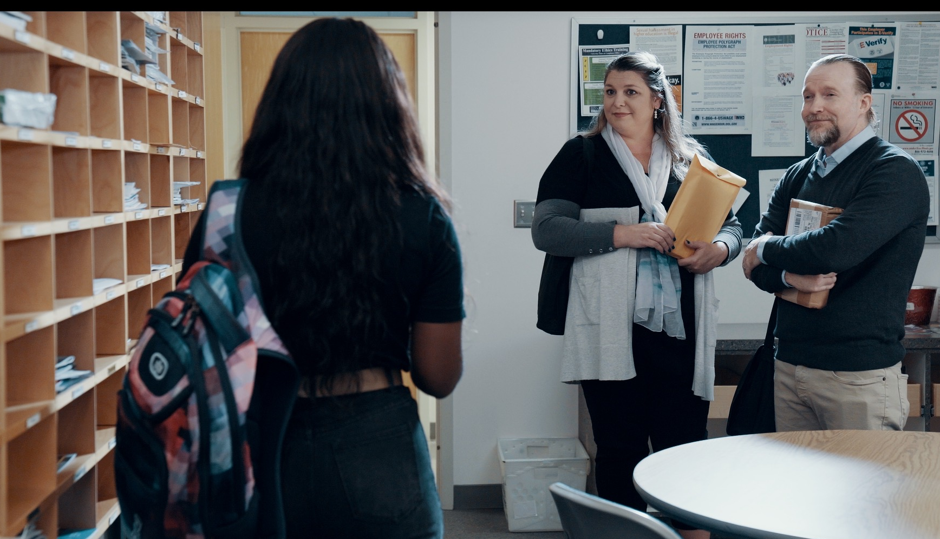
2.6 Facilitator Slides
Goals for Session
Agenda and Activities
Final Reflection
ncpre

Slide 2
2.5 Session Goals
GOALS:
Share the work that you are doing on your own as you go through the course
Reflect on your learning
Practice some of the tools that you were introduced to in the course
Get to know others in your lab/class
STRUCTURE:
Will meet every _ weeks for _ hours
Large and small group discussions
Reflection, Better Science, and Lab Manual questions can be part of each session

Slide 3
Activities and
Discussions
ncpre

Slide 4
Microaggressions
All Jayna wants to do is her research, and it’s hit a roadblock. On her way to what she expects is going to be another frustrating day in the lab, she encounters microaggressions and incivility from senior colleagues. The interaction carries implicit messages that she doesn’t belong, set against reminders of external societal inequities.
Discuss the following questions in your small groups (10-15 Minutes):
How would you have liked to respond if you had been in Jayna’s place?
Imagine having such experiences at work, repeatedly. When you are present when others have experiences like Jayna, what, responsibility do you feel to speak up?
How would you like your colleagues to respond?

Slide 5
Microaggressions
Large Group Discussion
Share one or two key takeaways from your small group discussion with the whole group (5-10 Minutes).
As a large group, discuss this question (5-10 Minutes):
How do these experiences undermine a culture of excellence?
What lab practices could help handle such situations?

Slide 6
Practice - Using the Personal Scripts
How might things be different in a situation of incivility or bias and the person to whom you are responding is of greater power and status?
With your small group, write down 2-3 personal scripts that you could use towards a person of higher power or status in the following situations (15 Minutes):
When you are in a situation where you are experiencing bias or incivility
When you are listening to someone else talk about a time when they experienced bias or incivility:
When you are a bystander and you observe someone who is experiencing bias or incivility:
Share your ideas with the larger group (10 Minutes)

Slide 7
Better Science Discussion
The frustrations between the two labs in this scenario stem from a collaboration that isn’t going well. The Heideberg lab is unable to reproduce the molecule that they need to share with the Sorenson lab.
Discuss the following questions with your groups (10-15 Minutes):
In the scene, Darren asserts that the two sample are the same molecule; on what basis does he make that statement?
Describe the science that allows him to know this.
Why/how might he be in error? What are some check against error for him/for you in your lab?

Slide 8
Lab Manual Discussion Questions
Consider how at the center of these scenes are issues of creating a culture of inclusion, upstanding, and openness.
In small groups, discuss the following (5-10 Minutes):
From the sample lab manuals, which elements/sections did you particularly like for building your lab culture of excellence?

