Slide 1
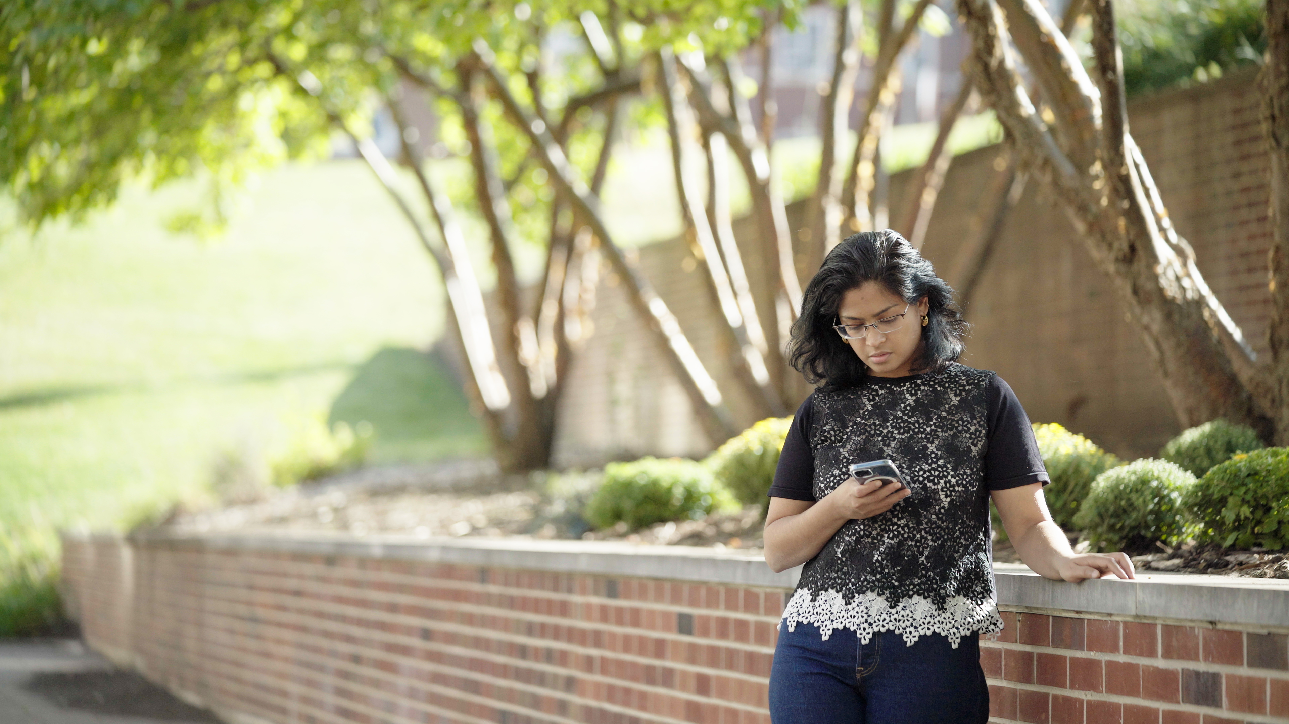
2.10 Facilitator Slides
Goals for Session
Agenda and Activities
Final Reflection
ncpre

Slide 2
2.10 Session Goals
GOALS:
Share the work that you are doing on your own as you go through the course
Reflect on your learning
Practice some of the tools that you were introduced to in the course
Get to know others in your lab/class
STRUCTURE:
Will meet every _ weeks for _ hours
Large and small group discussions
Logbook Activities, Program Reflection, Better Science, and Lab Manual questions can be part of each session

Slide 3
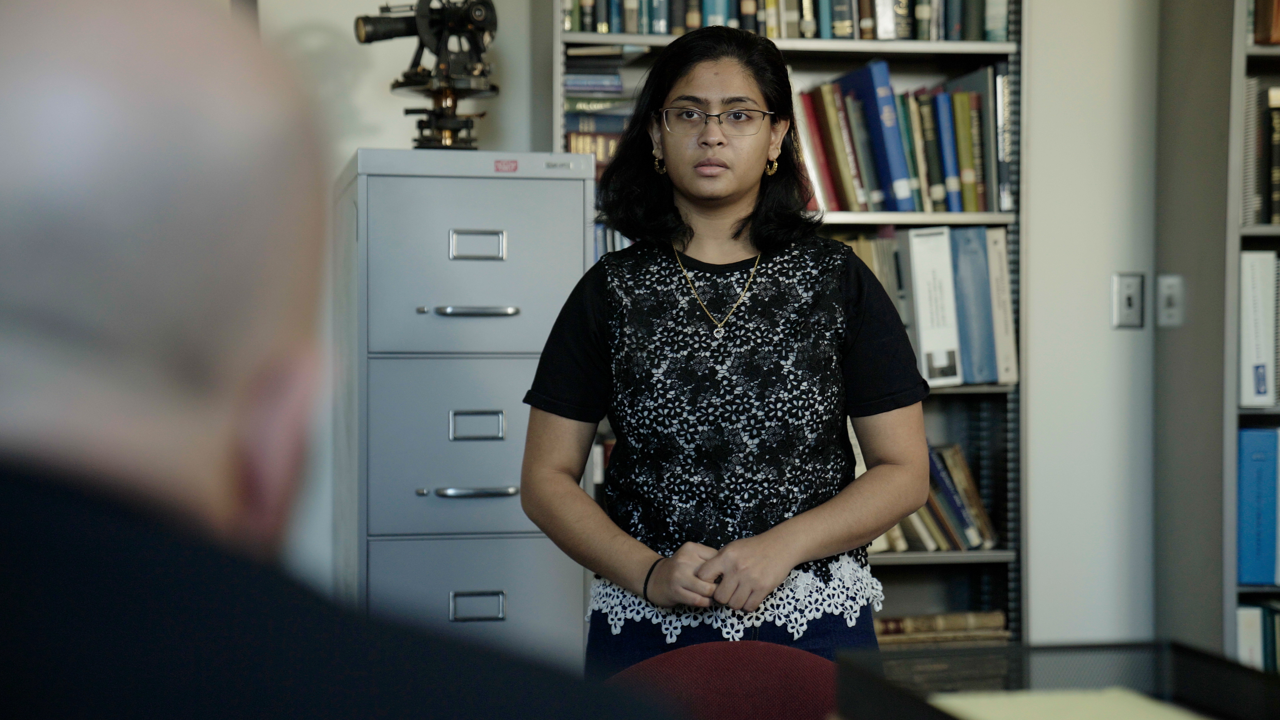
Activities and
Discussions
ncpre

Slide 4
Recognizing Stress in Others
Meena and Harold have asked for help in different ways throughout the film. In each of these instances, they were uneasy, or even frightened, to ask for the help they needed. This is indicative of a culture of fear in the Heideberg lab—one in which asking questions or making mistakes is seen as a sign of weakness.
Discuss the following questions in your small groups (10-15 Minutes):
Thinking about the places where you feel like you belong, and feel accepted and valued, what are elements in that environment that are missing from the Heideberg lab?
How are those missing elements part of a lab culture?
If you were to become a lab leader yourself, what would you do to foster psychological safety in the lab?

Slide 5
Dealing with Failure
Large Group Discussion
Share one or two key takeaways from your small group discussion with the whole group (5-10 Minutes).
As a large group, discuss (5-10 Minutes):
Ways to foster psychological safety in the lab

Slide 6
Practice – Supporting Mental Health
To support their well being, their careers, and our own careers—and to prevent unnecessary setbacks—we and they must know that stressful, yet usually temporary, situations can be addressed. Supporting others can take many forms, depending on your personality, comfort talking about emoitions, and experience withy those around you.
Individually, go through the list on the next slide of actions one could take to help a struggling colleague. Ask yourself which 4-5 behaviors you are most comfortable doing, and 4-5 behaviors you would feel least comfortable doing (3-5 Minutes).

Slide 7
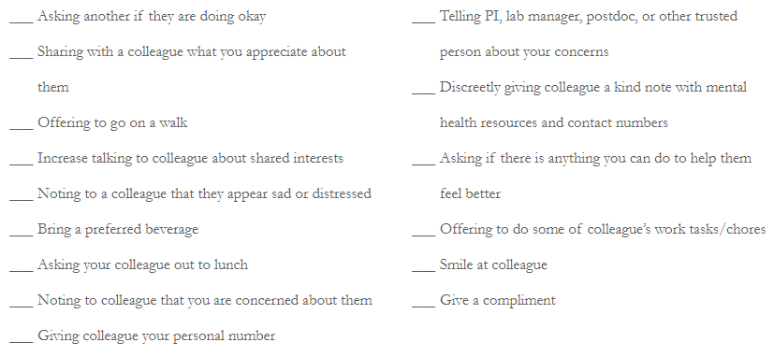
Practice – Supporting Mental Health
Share with your group which was most and least comfortable (10-15 Minutes):
Were some actions widely viewed as more/less comfortable?
Did you have actions that were easier for some and difficult for others?

Slide 8
Better Science Discussion
The frustrations at the Heideberg Lab in this episode are due to a culture of fear; one in which asking questions or making mistakes is seen as a sign of weakness.
Discuss the following questions with your groups (10-15 Minutes):
In what ways does the science being conducted in a lab suffer, if lab members do not feel safety to speak about their struggles and concerns?
What protocols/processes/support can be put in place to make sure that lab members can do the best science?

Slide 9
Lab Manual Discussion Questions
This scene focuses on recognizing and supporting issues of mental health and wellbeing in the workplace.
In small groups, discuss the following (5-10 Minutes):
What resources will you include in your lab manual to address issues of mental health and wellbeing?
What resources and actions might increase the feeling of the lab's psychological safety?
How might you meaningfully integrate support [through words, actions, and written expectations/policies] into the work of your lab for the benefit of both those who might be struggling, and those who want to be supportive??

