Slide 1
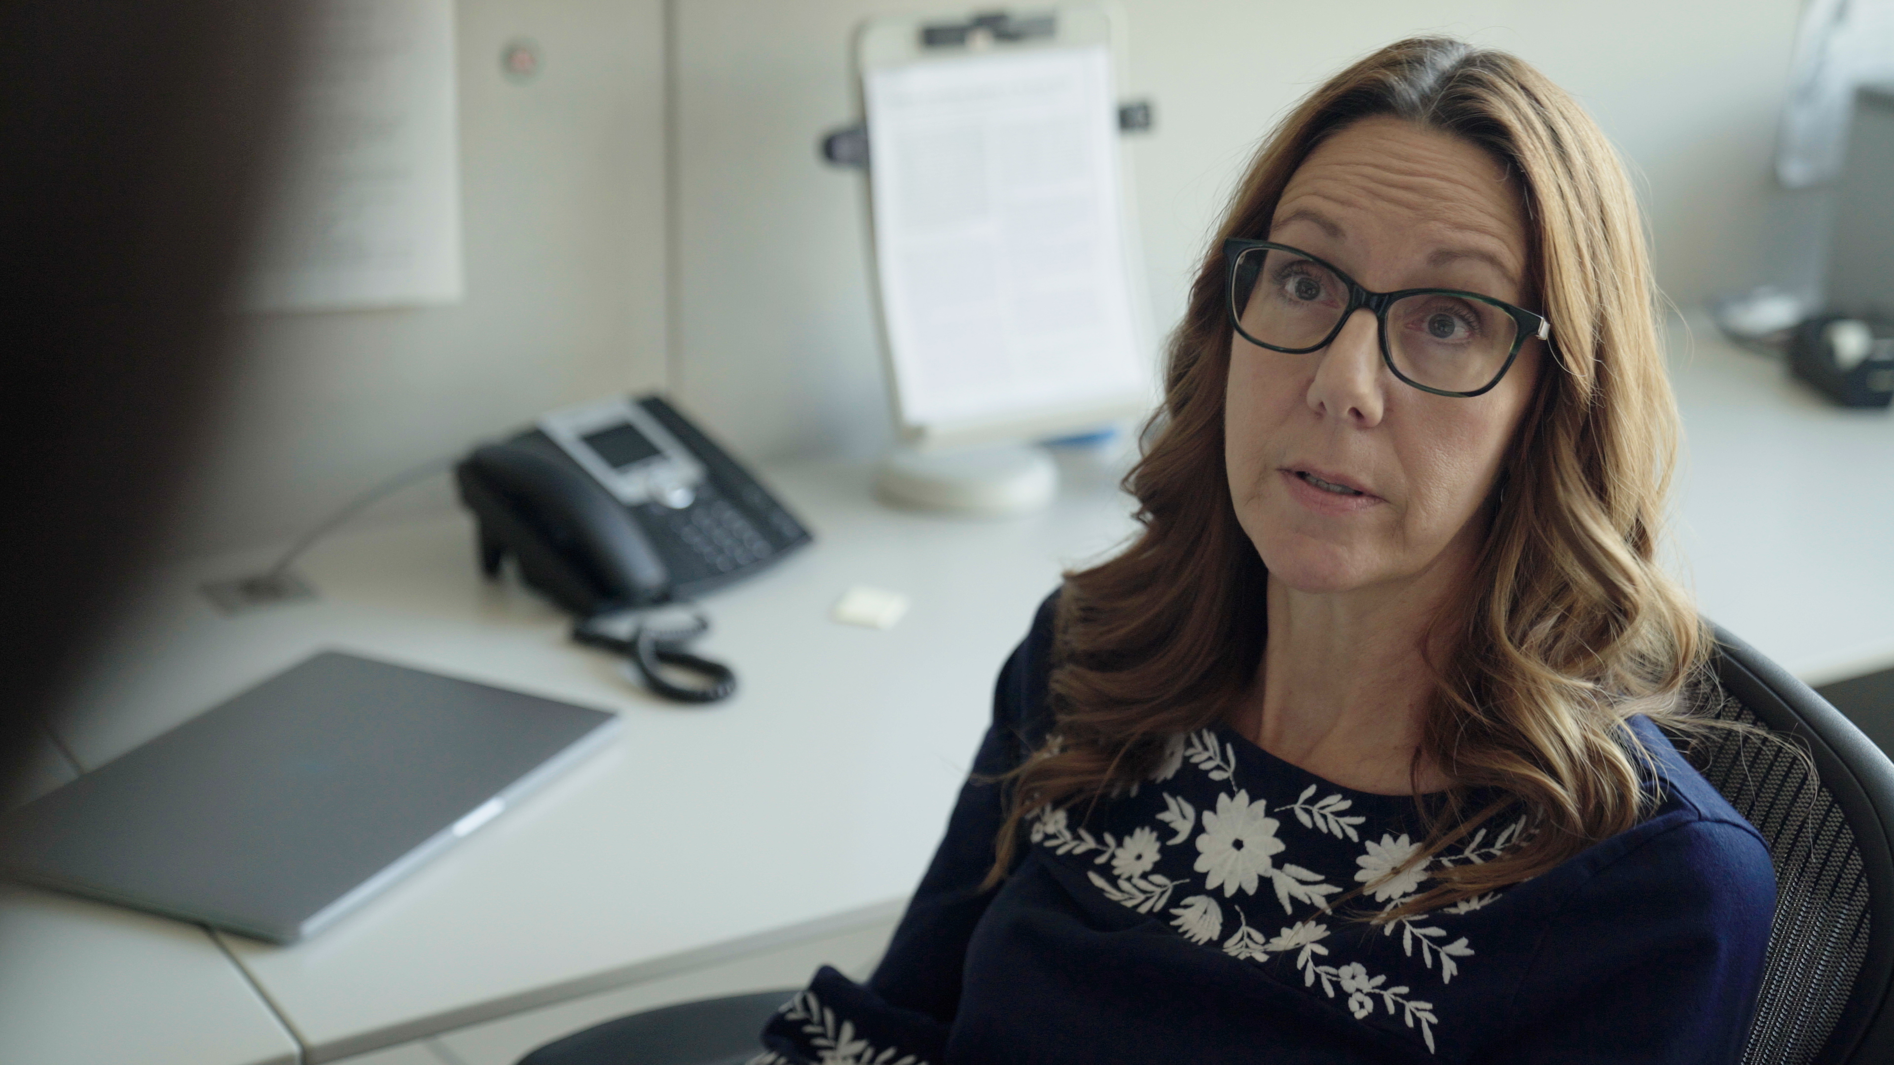
2.11 Facilitator Slides
Goals for Session
Agenda and Activities
Final Reflection
ncpre

Slide 2
2.11 Session Goals
GOALS:
Share the work that you are doing on your own as you go through the course
Reflect on your learning
Practice some of the tools that you were introduced to in the course
Get to know others in your lab/class
STRUCTURE:
Will meet every _ weeks for _ hours
Large and small group discussions
Logbook Activities, Program Reflection, Better Science, and Lab Manual questions can be part of each session

Slide 3
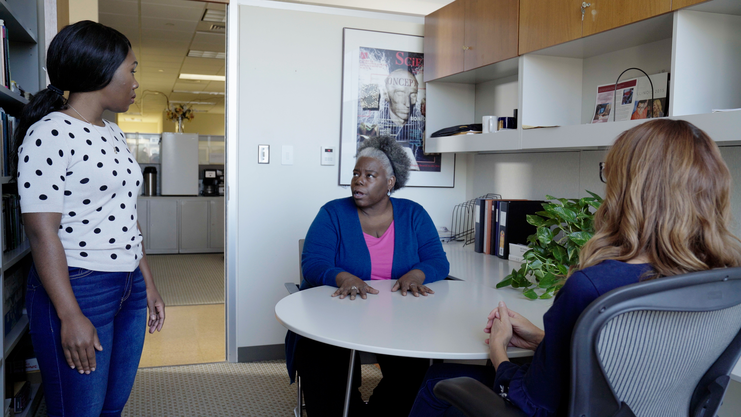
Activities and
Discussions
ncpre

Slide 4
Mentoring Networks
Developing your understanding of mentoring relationships—both for being mentored and for mentoring others, formally or informally—will benefit you throughout your career. In a recent contribution to Letters to Young Scientists, a column which is a regular feature of Science, the authors note: "Mentors may try to provide the type of mentoring they wished they had received in graduate school, failing to realize different students have different needs and require individualized guidance"
Discuss the following questions in your small groups (10-15 Minutes):
What sort of mentoring do you wish to receive? What doesn’t work for you?
How would you guard against mentoring trainees on the assumption that the same things that are important to you are also important to them?

Slide 5
Mentoring Networks
Share one or two key takeaways from your small group discussion with the whole group (5-10 Minutes).
Discuss this question with the larger group (5-10 Minutes):
Many mentors adopt the prctices that their own mentors used, without realinzing that the individual in front of them might need something different. How can you work to recognize that not every approach may be appropriate for each lab member?

Slide 6
Practice – Supporting Mental Health
Limiting yourself to one mentor is not realistic in terms of the range of needs you will encounter across your career. Developing your understanding of mentoring relationships—both for being mentored and for mentoring others, formally or informally—will benefit you throughout your career.
Take a moment individually (5 minutes):
Create a list of 1-2 possible mentors for you in the following ways:
Personal Accountability
Emotional Support
Role Models
Career Development
Professional References
In your small group, share and discuss your choices (10-15 minutes)

