Slide 1
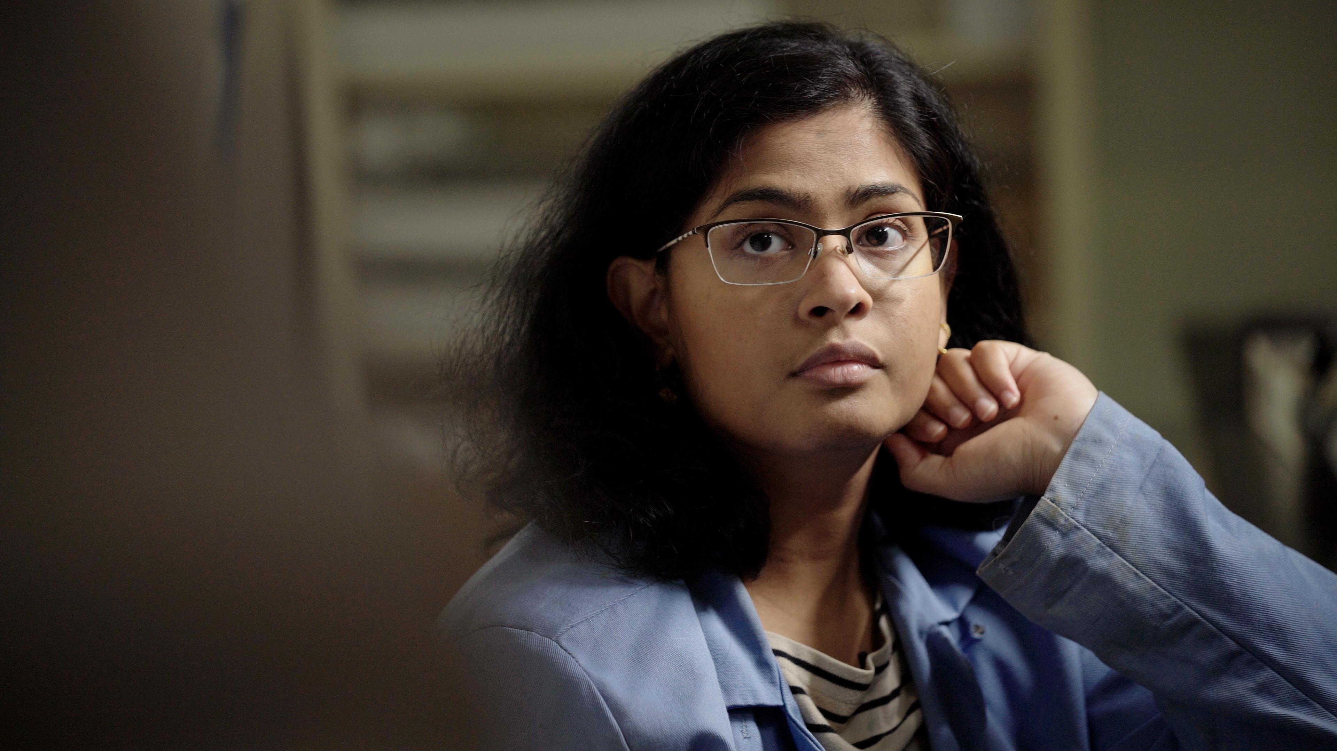
2.12 Facilitator Slides
Goals for Session
Agenda and Activities
Final Reflection
ncpre

Slide 2
2.12 Session Goals
GOALS:
Share the work that you are doing on your own as you go through the course
Reflect on your learning
Practice some of the tools that you were introduced to in the course
Get to know others in your lab/class
STRUCTURE:
Will meet every _ weeks for _ hours
Large and small group discussions
Logbook Activities, Program Reflection, Better Science, and Lab Manual questions can be part of each session

Slide 3
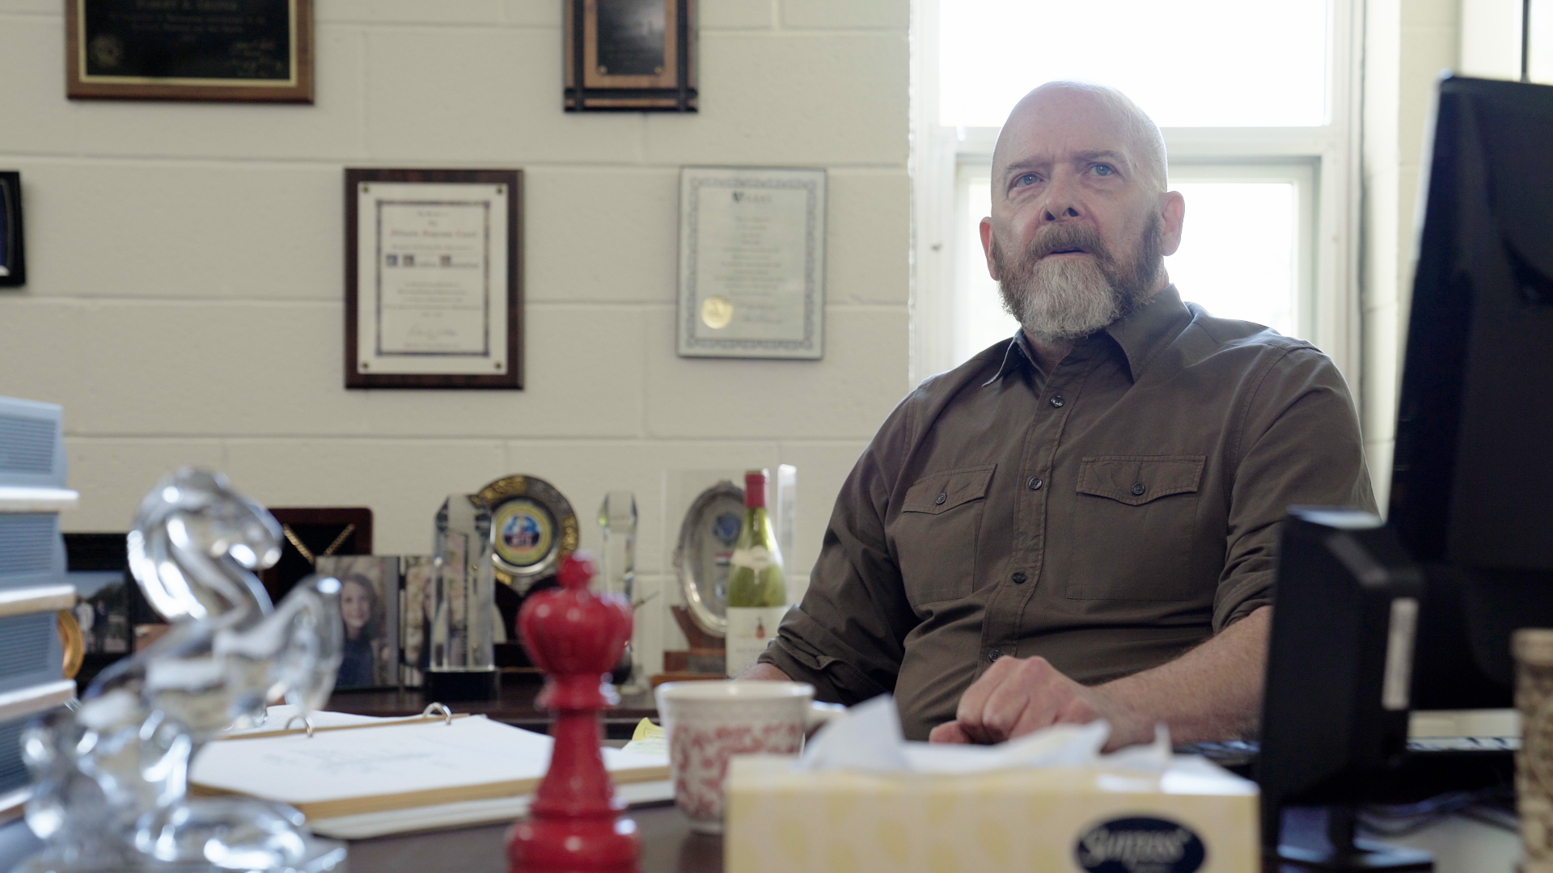
Activities and
Discussions
ncpre

Slide 4
Resources and Being an Ally
In this scene, we find out that Malcom Heideberg didn’t realize how bad things were in his lab and Harold’s attempted suicide and subsequent departure from the lab. The logbook asks you to consider, if you were in charge of the lab, what you would include in a manual or strive to make part of the working climate to support lab members to deal with difficult emotional issues
Discuss the following questions in your small groups (10-15 Minutes):
If you oversaw a department or research institution, what would be different?
How would you create an institution-wide safety net for struggling lab members?
How would you suggest knitting together all the various and silo-ed programs that might currently exist to strengthen that net?

Slide 5
Resources and Being an Ally
Large Group Discussion
Share one or two key takeaways from your small group discussion with the whole group (5-10 Minutes).
Write down suggestions from the smaller groups on creating an institution-wide safety net

Slide 6
Practice – Identifying Resources Questions
With your small groups, discuss and identify one specific resources from the following categories. (10 Minutes):
Individuals who are peers
Individuals who are mentors/advisors
Department or Institutional resources
Community Resources
Hotline phone numbers or websites
Activities outside work that support your well-being

Slide 7
Lab Manual Discussion Questions
Consider how at the center of these scenes are issues of mental health, resources, and cultures of excellence.
In small groups, discuss the following (5-10 Minutes):
Share with others the resources you've identified for fostering mental health and creating a positive and inclusive working environment?
What is still missing that you could add to the lab manual?

