Slide 1
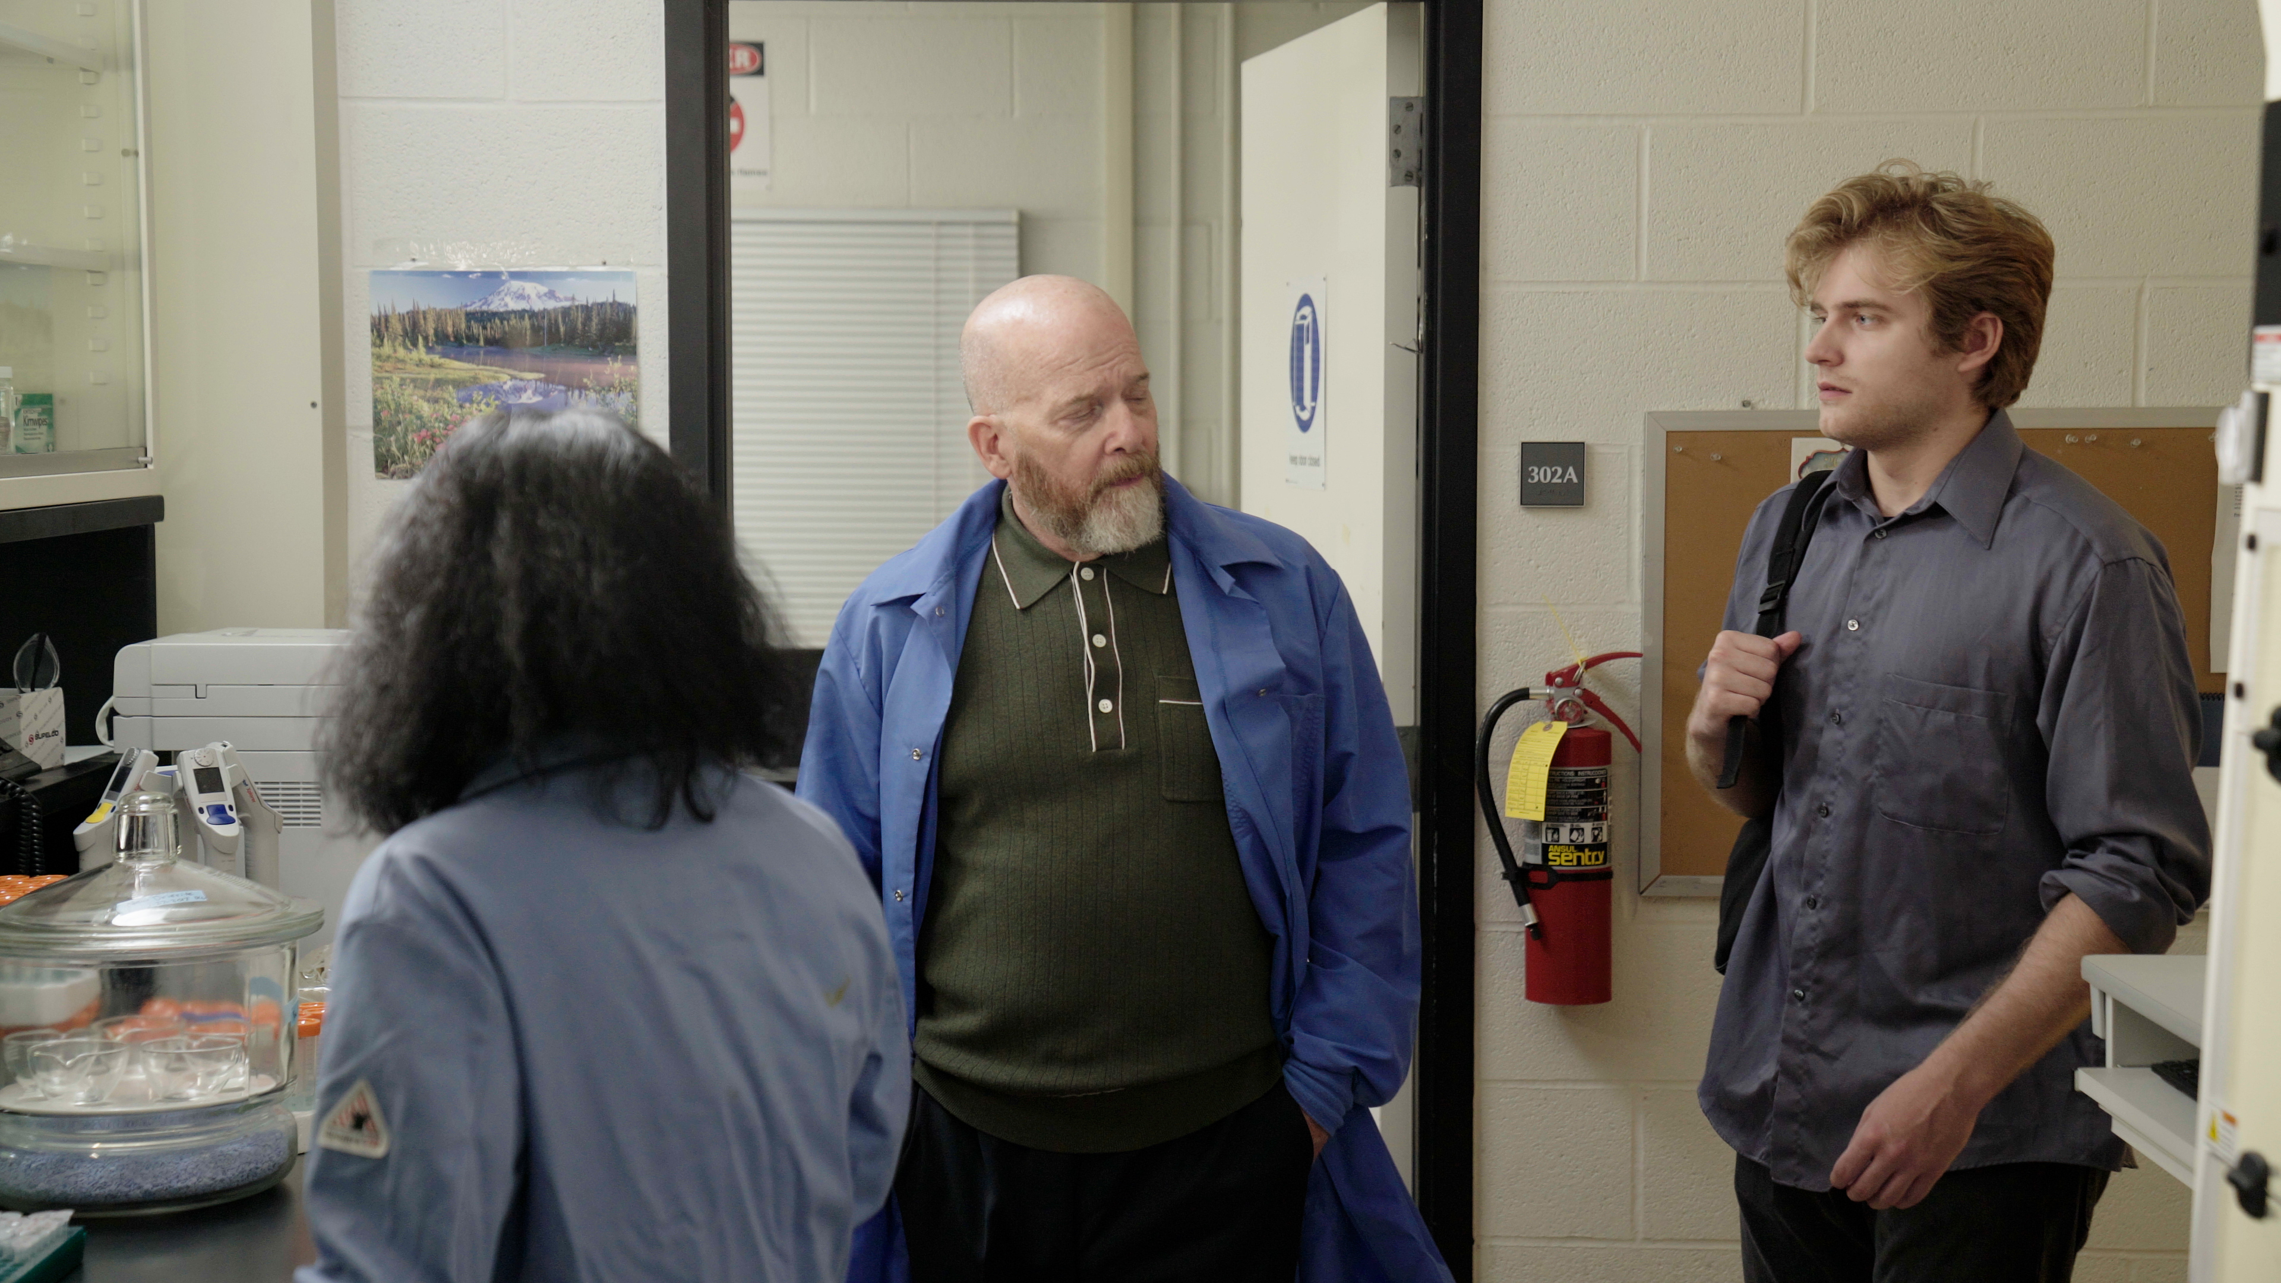
2.7 Facilitator Slides
Goals for Session
Agenda and Activities
Final Reflection
ncpre

Slide 2
2.7 Session Goals
GOALS:
Share the work that you are doing on your own as you go through the course
Reflect on your learning
Practice some of the tools that you were introduced to in the course
Get to know others in your lab/class
STRUCTURE:
Will meet every _ weeks for _ hours
Large and small group discussions
Logbook Activities, Program Reflection, Better Science, and Lab Manual questions can be part of each session

Slide 3
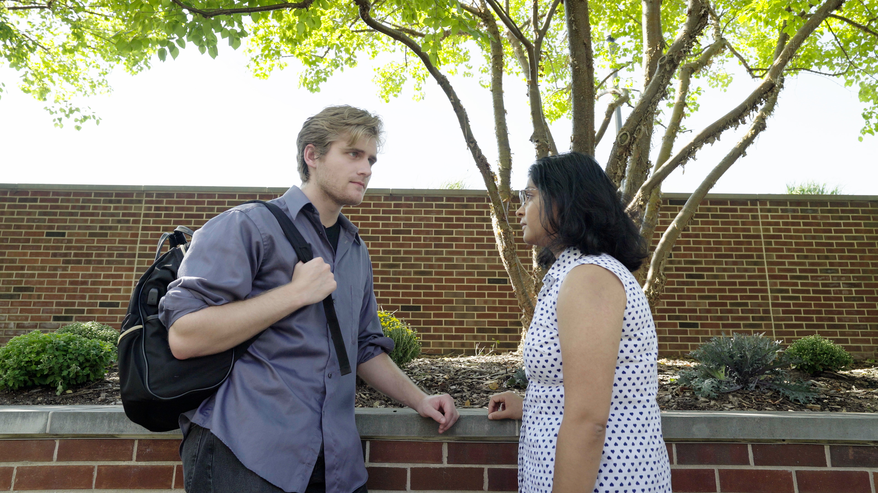
Activities and
Discussions
ncpre

Slide 4
Mental Health and Dealing with Failure
The pursuit of science, like life more broadly, contains moments of failure. We invest in lab members and coworkers in pursuit of producing strong science. While it is natural to try to avoid failure, many important scientific discoveries emerged through, or despite, mistakes. In this scene, Meena fails, as Harold did, to make the compound.
Discuss the following questions in your small groups (10-15 Minutes):
One thing that is certain in science is that there will be mistakes in the work we’re doing. How can a lab leader set the tone for using those mistakes as a learning opportunity?
How can the kind of feedback you get about a mistake inhibit or encourage true learning?
How can a lab head reasonably balance the expectation of good science [accurate results] with compassion for/acceptance of human fallibility?

Slide 5
Mental Health and Dealing with Failure
Share one or two key takeaways from your small group discussion with the whole group (5-10 Minutes).

Slide 6
Practice – Self talk and THINK
The way we talk to ourselves is important. And yet, often, our first thoughts are not our most encouraging messages about ourselves or our abilities.
One method that can help make your self-talk more constructive is to consider the acronym T.H.I.N.K. before you speak to yourself. Take the self-statement, “I’m stupid and I will never complete this task.” Is this statement:
With your small group, walk through THINK with the following statements and work on trying to reframe your self speech (10-15 Minutes):
“What did I expect, I am terrible at writing papers”
“If I continue making this mistake I will be kicked out of the lab”
“Soon everybody will learn that I am incompetent”
“I might as well not apply for this grant. I will never get it”

Slide 7
Better Science Discussion
The frustrations between the two labs in this scenario stem from a collaboration that isn’t going well. There are issues with a compound that Darren made that no one else is able to reproduce.
Discuss the following questions with your groups (10-15 Minutes):
When reproducing an experiment, how careful are you about recording each step in each attempt?
How do you account for what might be different from attempt to attempt in trying to reproduce an experiment?
What are best practices for labs to tackle this issue?

Slide 8
Lab Manual Discussion Questions
This scene focuses on lab protocols and giving and receiving feedback.
In small groups, discuss the following (5-10 Minutes):
How will you tackle issues of replication and tracking procedures?
What kinds of resources might you include about feedback (both giving and receiving) in the lab manual?
How will you practice that in the lab?

