Slide 1
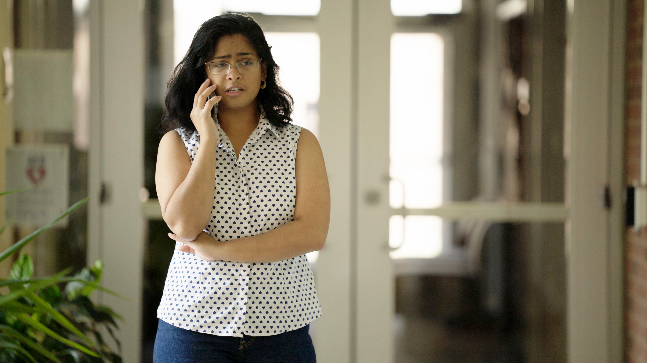
2.8 Facilitator Slides
Goals for Session
Agenda and Activities
Final Reflection
ncpre

Slide 2
2.8 Session Goals
GOALS:
Share the work that you are doing on your own as you go through the course
Reflect on your learning
Practice some of the tools that you were introduced to in the course
Get to know others in your lab/class
STRUCTURE:
Will meet every _ weeks for _ hours
Large and small group discussions
Logbook Activities, Program Reflection, Better Science, and Lab Manual questions can be part of each session

Slide 3
Activities and
Discussions
ncpre

Slide 4
2 Minute Challenge
After running the analysis, your first thought was: “I can’t be right. I’m just a grad student, after all. Could an entire sub-field of research really be based on a fundamental error?” And yet, the conclusion is unavoidable. You’ve checked and rechecked your analysis, and a central analytical approach your group used in several publications (indeed, one used by scores of other research groups, as well) is vulnerable to bias. It dawns on you that the problem could compromise hundreds of related articles from other labs. What do you do?
Start a timer, take 2 minutes to write down answers to the 6 questions of DMF Framework

Slide 5
2 Minute Challenge - Reflection
Share and contrast your responses for each step with members of your small group (10-15 Minutes):

Slide 6
Data and Lab Management
Having finished the 2-Minute Challenge with your group, think about the overall themes as you compare responses.
With your small group, discuss the following (10-15 Minutes):
What portion of your responses were finding support for the stress? What portion were about fear of raising unwanted conclusions and possible reprisals.
What portion of your responses were regarding the process moving forward?
How different were the proportions of your responses compared to your other group members? What can you learn from that?

Slide 7
Lab Manual Discussion Questions
This scene focuses on lab protocols and data management.
In small groups, discuss the following (5-10 Minutes):
For the specific projects in your lab, which of the data domains need the most work?
Which of the domains do you imagine being the easiest to address?
The most difficult??

