Slide 1
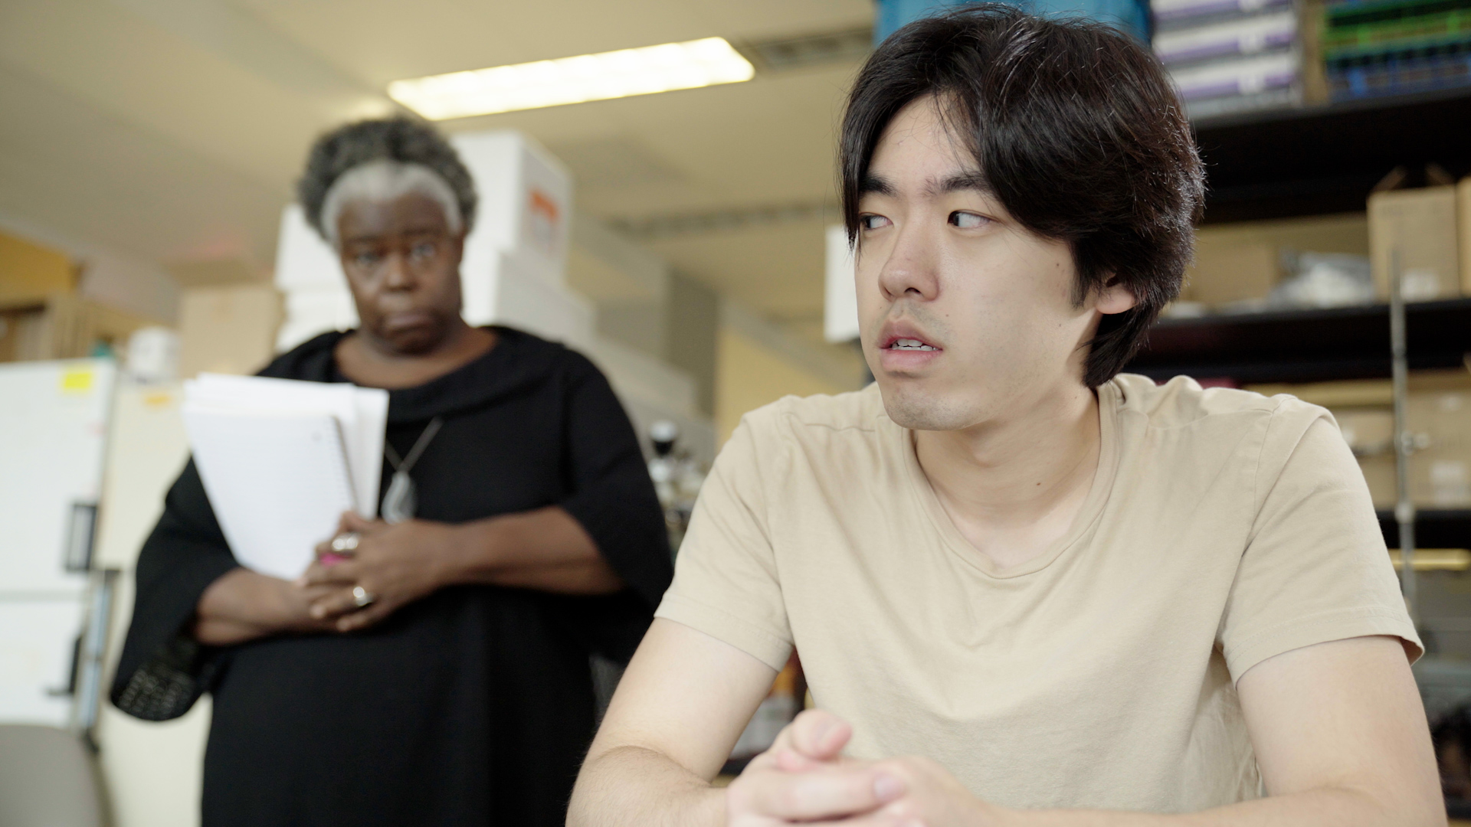
2.9 Facilitator Slides
Goals for Session
Agenda and Activities
Final Reflection
ncpre

Slide 2
2.9 Session Goals
GOALS:
Share the work that you are doing on your own as you go through the course
Reflect on your learning
Practice some of the tools that you were introduced to in the course
Get to know others in your lab/class
STRUCTURE:
Will meet every _ weeks for _ hours
Large and small group discussions
Logbook Activities, Program Reflection, Better Science, and Lab Manual questions can be part of each session

Slide 3
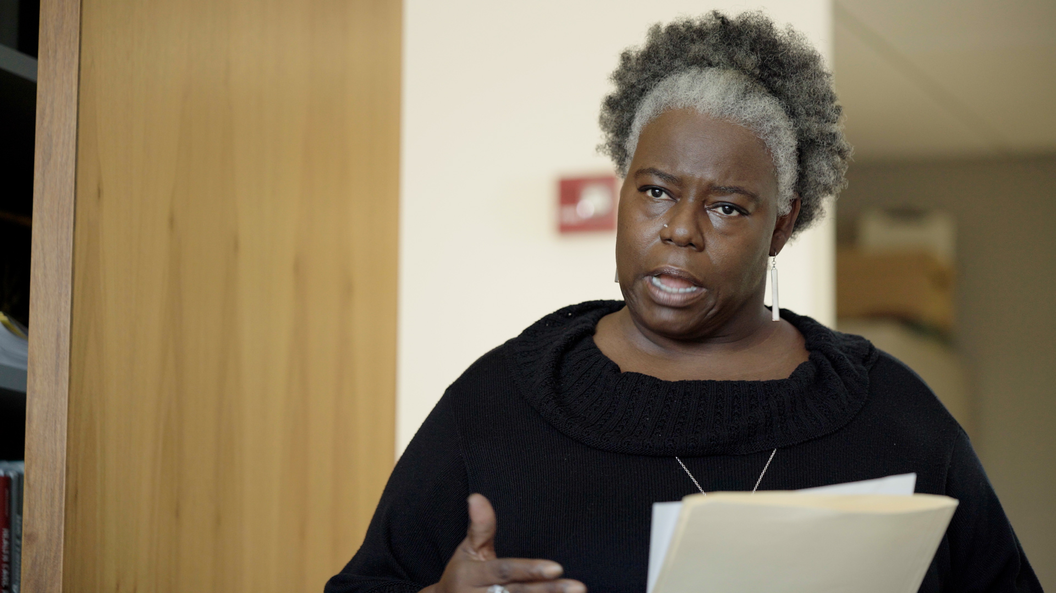
Activities and
Discussions
ncpre

Slide 4
Power and Questions
Questions are a powerful communication tool. Different situations warrant different types of questions. Do you need to gain consensus? Diagnose a problem? Learn something new? In this scene, Loretta’s communication strengths lie in listening and asking questions. She's able to connect with Alex by observing his discomfort and asking the right questions.
Discuss the following questions in your small groups (10-15 Minutes):
Think about the last substantive question you were asked. Was it confrontational, influential, problem-solving, curious, or some combination of these? If the question didn't quite work (e.g., the purpose wasn't clear, or it made you feel uncertain in your response, or it felt aggressive), how would you re-phrase that question to be a more effective one?
What did the last question you were asked help you learn?

Slide 5
Power and Questions
Large Group Discussion
Share one or two key takeaways from your small group discussion with the whole group (5-10 Minutes).
As a large group, discuss (5-10 Minutes):
Thinking back to feedback you've received when you made a mistake, how might that feedback have been more effective if posed in question form?
How might an approach of questioning, rather than telling, help you better learn from your mistake?

Slide 6
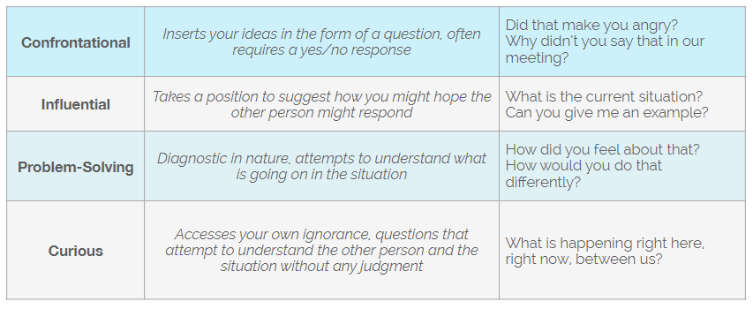
Practice – Asking Questions
Consider a situation you are facing at work. Write one type of question from each category that you could use in a conversation.
Share your questions/situations with your groups (10-15 Minutes)

Slide 7
Practice – Asking Questions
Now, put yourself in the position of a principal investigator or senior researcher:
You have just been approached by two graduate students who have not been delivering.
One of the students is new, and the other student has a track record of underperforming.
Instead of solving their own problem, the students are asking you to take the valuable research time of a senior post doc to help them.
Consider the four categories of questions, and what you need from these two students.
With your small groups (10 Minutes):
Write out at least two questions you could ask in this scenario to get closer to a resolution and then discuss with your group.
Note and discuss which category the questions fall into
(1) Confrontational, (2) Influential, (3) Problem-solving, (4) Curious

Slide 8
Better Science Discussion
Key to the topic of this episode is the general disarray of the lab notebooks in the Sorenson Lab.
Discuss the following questions (10-15 Minutes):
What controls should be in place to ensure that all relevant information makes it into a lab notebook?
What IS relevant information [while that might differ project to project, are there any pieces of information that should ALWAYS be included in a lab notebook?]?
How can lab members hold each other accountable?

Slide 9
Lab Manual Discussion Questions
Consider how at the center of these scenes are issues of communication, specifically asking questions and creating a culture of civility and disclosure.
In small groups, discuss the following (5-10 Minutes):
How could this specific aspect of communication -- asking effective questions -- Sbest be addressed in a lab manual?

