Slide 1
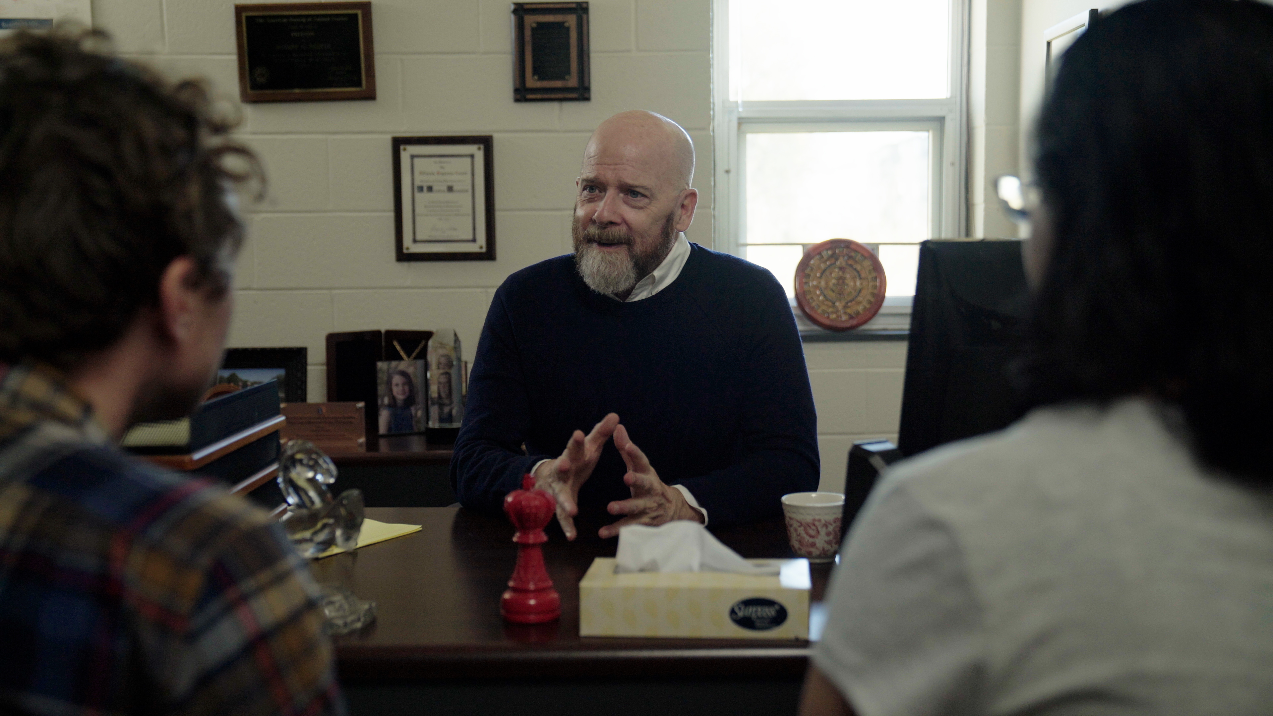
3.1 Facilitator Slides
Goals for Session
Agenda and Activities
Final Reflection
ncpre

Slide 2
3.1 Session Goals
GOALS:
Share the work that you are doing on your own as you go through the course
Reflect on your learning
Practice some of the tools that you were introduced to in the course
Get to know others in your lab/class
STRUCTURE:
Will meet every _ weeks for _ hours
Large and small group discussions
Logbook Activities, Program Reflection, Better Science, and Lab Manual questions can be part of each session

Slide 3
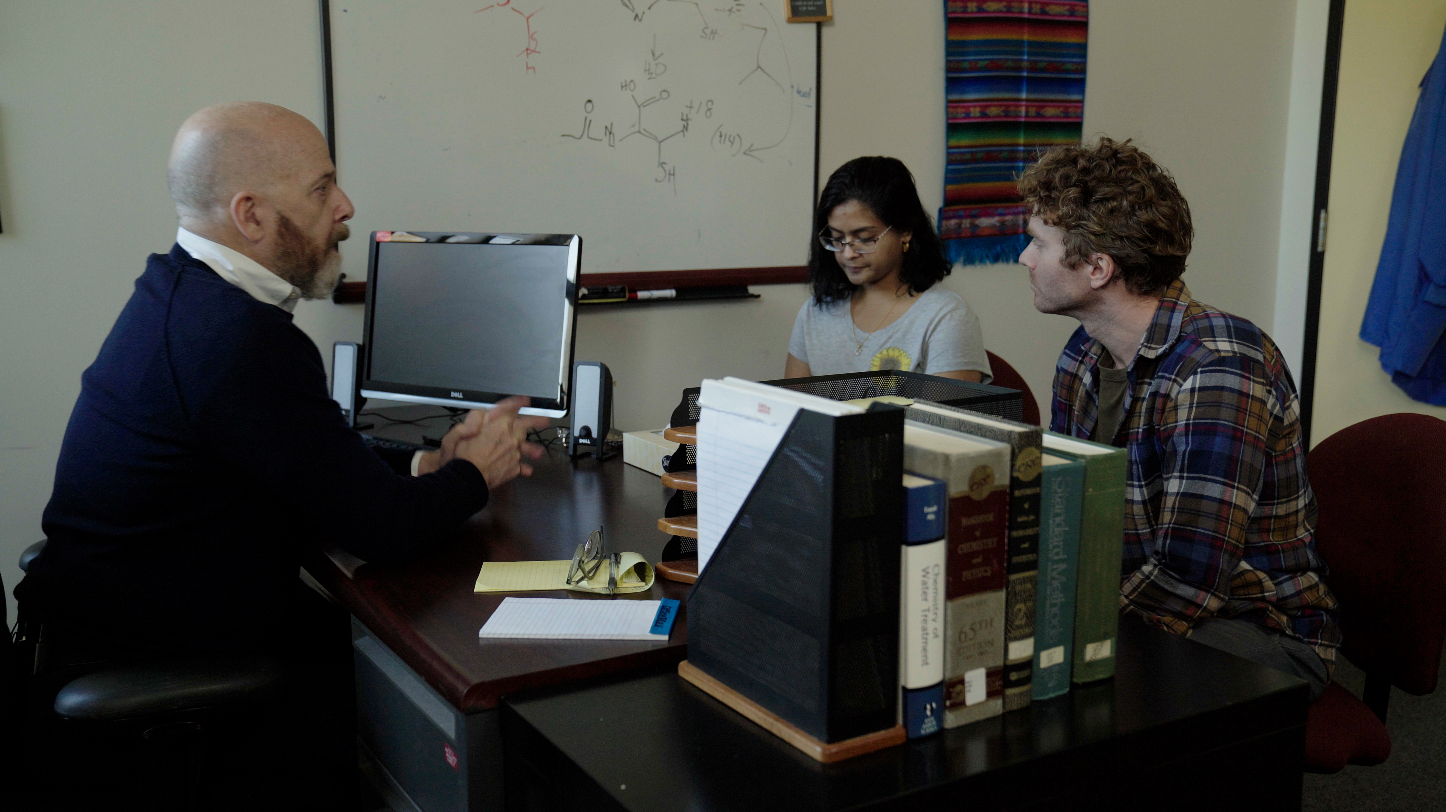
Activities and
Discussions
ncpre

Slide 4
Wellness and Empathy
Malcolm Heideberg tells his lab that Harold has left without mentioning why, though some lab members– including Meena–know the truth. Think back to the logbook activities for Episodes 1.7 (Listening as Leadership), 2.9 (Power and Questions), and 2.10 (Recognizing Others' Stress). Knowing what you know now about the costs to Harold of the Heideberg lab culture, discuss what you might have said to the Harold you met in episode 2.7.
Discuss the following questions in your small groups (10-15 Minutes):
What can a lab group reasonably do to respond to instances like what happened to Harold?
What might taking stock of lab culture look like in reality?
How would you have used effective questioning, active listening, and supportive behaviors to reach out to Harold?
Ask one person to take notes for sharing with the larger group.

Slide 5
Wellness and Empathy - Recap
Share one or two key takeaways from your small group discussion with the whole group (5-10 Minutes).
Discuss as a large group:
Share the questions that you generated in the small group activity concerning wellness, empathy, and lab culture

Slide 6
Power and Bias
In a recent examination of students’ thoughts on mentor/mentee relationships, one student noted: “A key component to feeling confident about being a mentee is realizing that the relationship is symbiotic. This provides a frame to contribute to your mentor’s experience either through contributing to their work or promoting learning in terms of unknown knowledge. Recognizing the nature of the relationship makes me feel less guilty for seeking help as I now understand that it is a cycle that science development thrives on.”
Discuss the following questions in your small groups (10-15 Minutes):
In any one of your mentoring relationships, how clear are you on what you’re contributing to that mentor’s experience, and how clear are you on what they’re contributing to yours? Are her/his contributions meeting your needs?
How can each of the parties help sustain continuing mutual benefit?

Slide 7
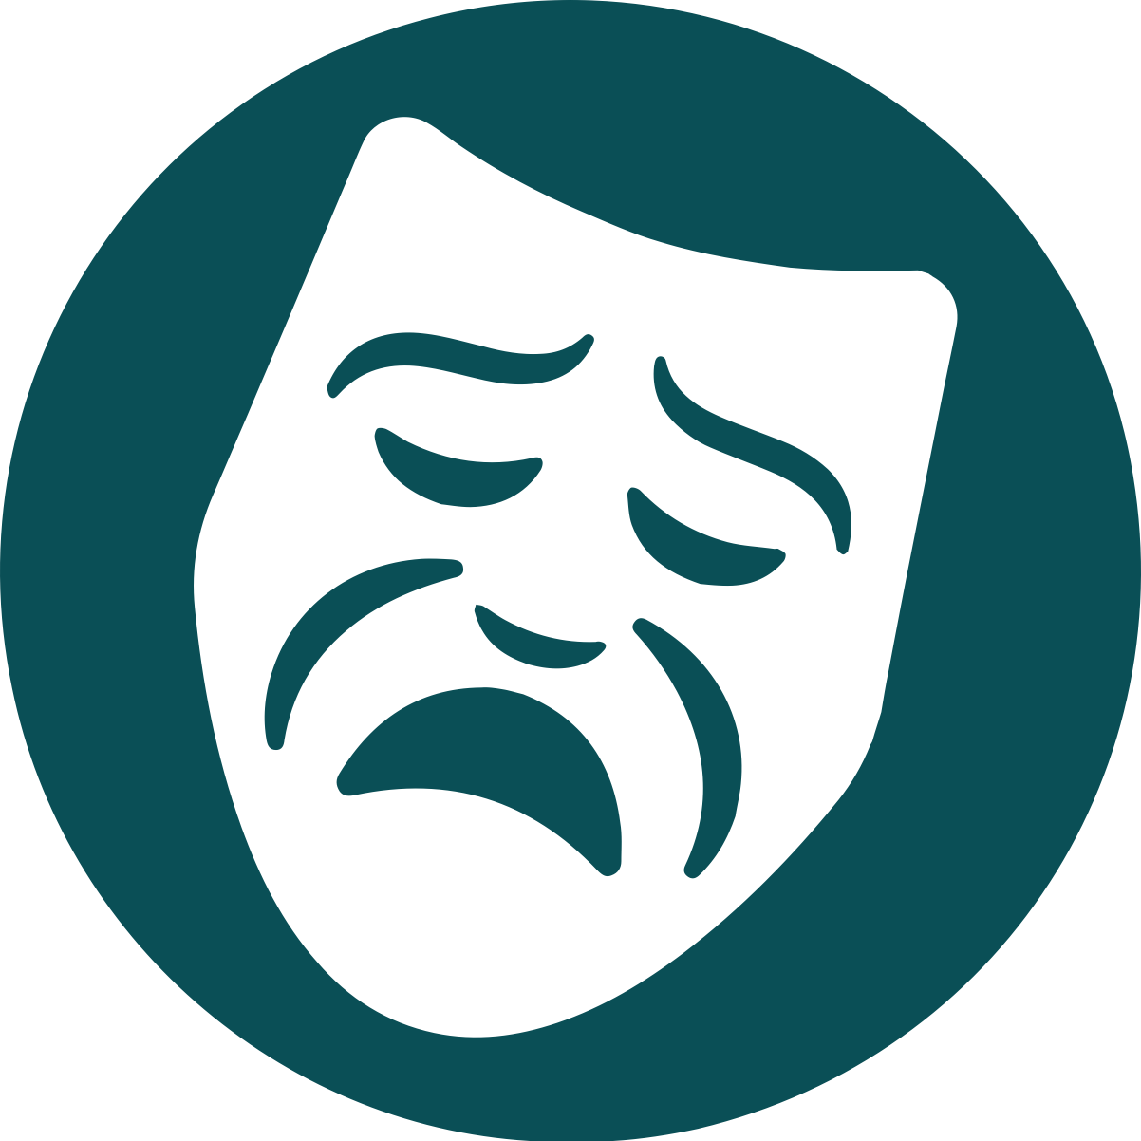
TRAGEDIES on Display
Consider the tools introduced through Acts One and Two: identifying Career TRAGEDIES in yourself, the DMF, developing personal scripts, listening effectively, and asking good questions.
With your small group, look up the tools and discuss the following (10-15 minutes):
What might you have done differently if you were a fellow lab member as Harold’s struggles and frustrations grew?
Which TRAGEDIES seem particularly salient to the situation with Harold?

Slide 8
TRAGEDIES on Display - Recap
With the larger group, share some of your answers from your small group discussion (5-10 Minutes):
What might you have done differently if you were a fellow lab member as Harold’s struggles and frustrations grew?
Which TRAGEDIES seem particularly salient to the situation with Harold?

Slide 9
Better Science Discussion
A toxic lab culture is a big issue for the Heideberg lab in this scenario. Think about the words that were used by the Lab Leader and how focusing on results and rigor can cross into unrealistic and impossible expectations.
Discuss the following questions (10-15 Minutes):
Heideberg tells Darren to help Meena so they can "find out where she's going wrong". What are the assumptions being made in that statement?
How can you better anticipate and keep track of possible sources of error?
Are their best practices that you are aware of that you could implement in your own work or lab?

Slide 10
Lab Manual Discussion Questions
Consider how the main conflict between the two labs ultimately stemmed from a single typo in the lab protocols.
In small group Discuss the Following (10 Minutes):
As a group, discuss this question from the logbook: "How do sections in a lab manual “live” so that they are used and can inform daily interactions?“
What can be done by leaders in the lab (whether that is the PI or members of the lab) to make sure these sections not only accurately reflect lab interactions, but also shape those interactions?

