Slide 1
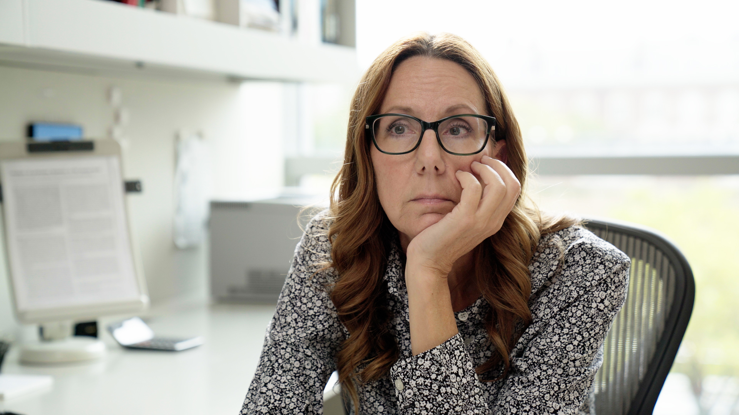
3.2 Facilitator Slides
Goals for Session
Agenda and Activities
Final Reflection
ncpre

Slide 2
3.2 Session Goals
GOALS:
Share the work that you are doing on your own as you go through the course
Reflect on your learning
Practice some of the tools that you were introduced to in the course
Get to know others in your lab/class
STRUCTURE:
Will meet every _ weeks for _ hours
Large and small group discussions
Logbook Activities, Program Reflection, Better Science, and Lab Manual questions can be part of each session

Slide 3
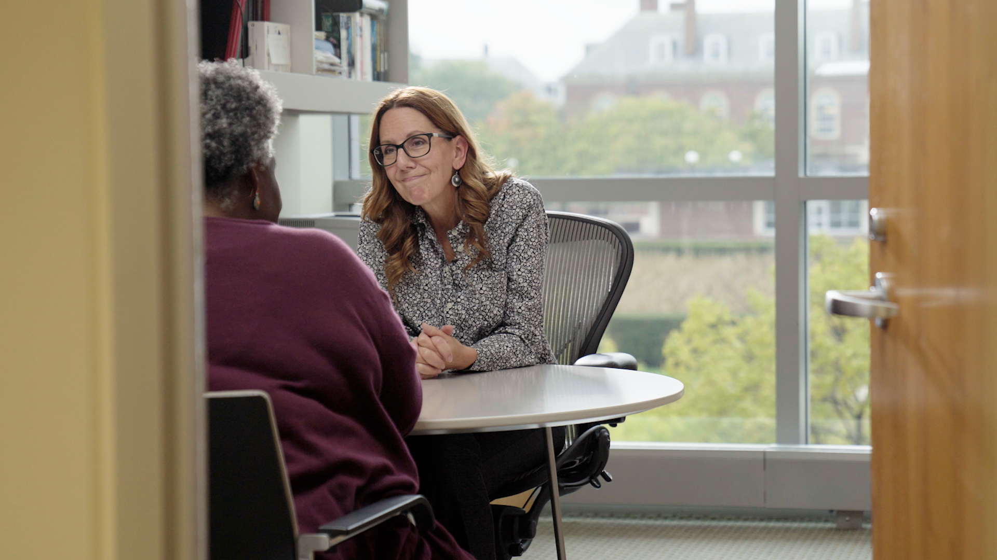
Activities and
Discussions
ncpre

Slide 4
Proactive Practices - Mentorship
Jules Sorenson engaged in self-reflection and realizes that her students have gotten a bit lost in the shuffle. She and Loretta agree to work together to create a better mentoring system and data management protocols.
Discuss the following questions in your small groups (10-15 Minutes):
What do you perceive might be some differences between a lab leader/research advisor and a mentor?
How might those differences impact relationships?
What might be some differences between a grad student/post doc and a mentee?
How might these differences impact the mentor/mentee relationship?
Ask one person to take notes for sharing with the larger group.

Slide 5
Mentorship - Recap
Share one or two key takeaways from your small group discussion with the whole group (5-10 Minutes).
Discuss as a large group:
Tension between being a good researcher vs mentor

Slide 6
Practicing Tools – Data Management
As Jules Sorenson grapples with how to improve the mentoring and support she is providing each of her students, she and Loretta are thinking about how to improve the lab’s systems and protocols for data and lab management. For the next activity, consider how you might do the same for your lab.
With your small group discuss the following (15 minutes):
How do data management practices contribute to cultures of excellence?
How do lab management protocols and practices interact with mentoring?
Is the mentoring you are receiving responsive to your needs and current development? If not, how can you express your needs in an effective, constructive way?

Slide 7
Lab Manual Discussion Questions
Discuss the following prompt from the LTW logbook with your small group:
“At the beginning of this program, you reflected on what a culture of excellence is and where you have seen such a culture in labs. Review your notes on the lab manual sections you have been developing through Acts One and Two. Reflect on how the iREDS approach to deliberative lab conversation, and other methods of communication, fit into your lab values. Consider how mentoring relationships can be most effective.”
In small group Discuss the Following (10 Minutes):
With this in mind, how might your lab philosophy (or mission statement) look like?
How will id describe your expectations of and contributions to a culture of excellence?
How often will you review and revise your philosophy?

