Slide 1
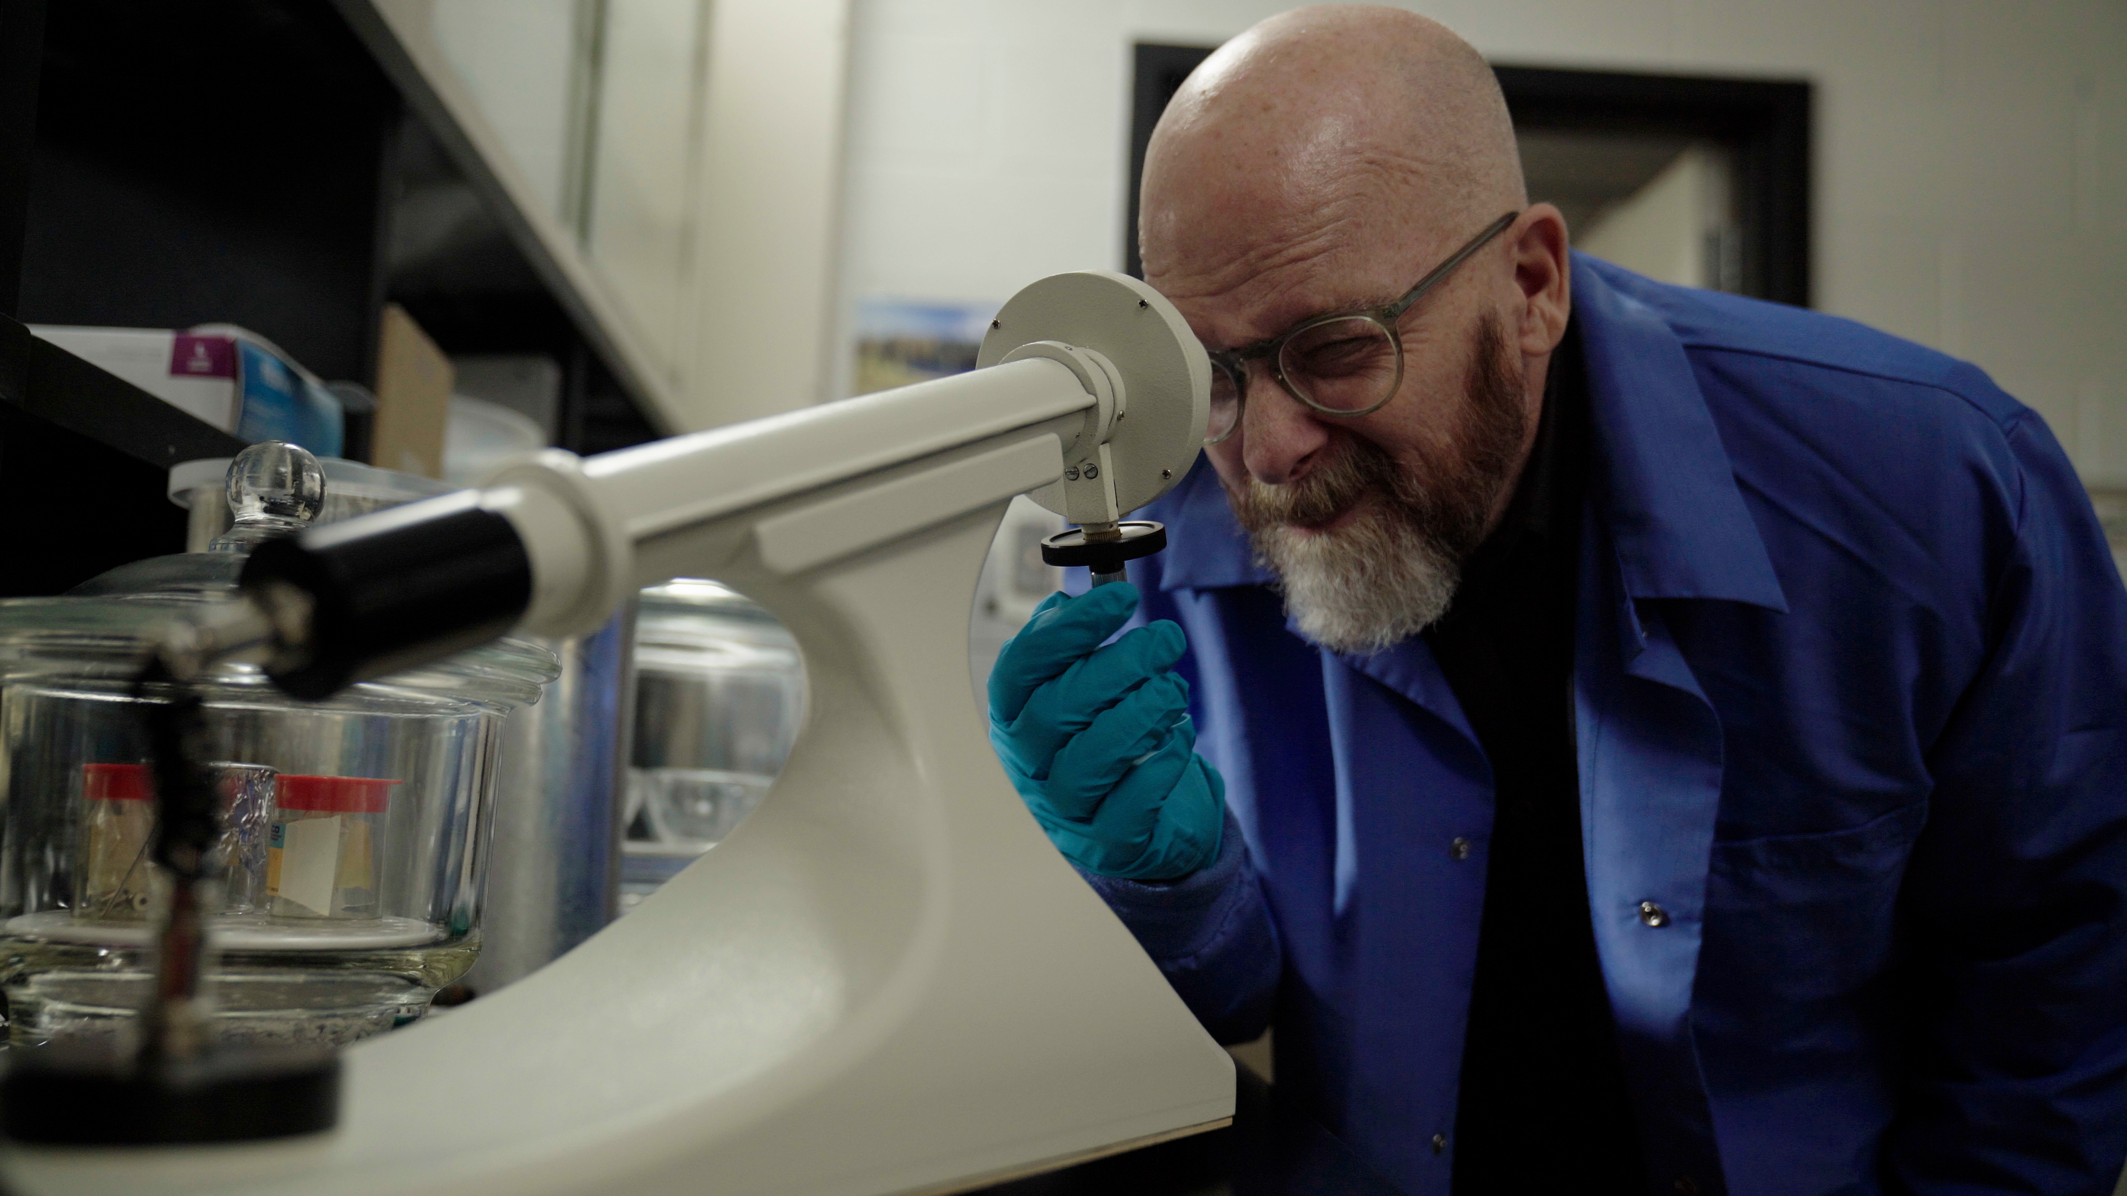
3.3 Facilitator Slides
Goals for Session
Agenda and Activities
Final Reflection
ncpre

Slide 2
3.3 Session Goals
GOALS:
Share the work that you are doing on your own as you go through the course
Reflect on your learning
Practice some of the tools that you were introduced to in the course
Get to know others in your lab/class
STRUCTURE:
Will meet every _ weeks for _ hours
Large and small group discussions
Logbook Activities, Program Reflection, Better Science, and Lab Manual questions can be part of each session

Slide 3
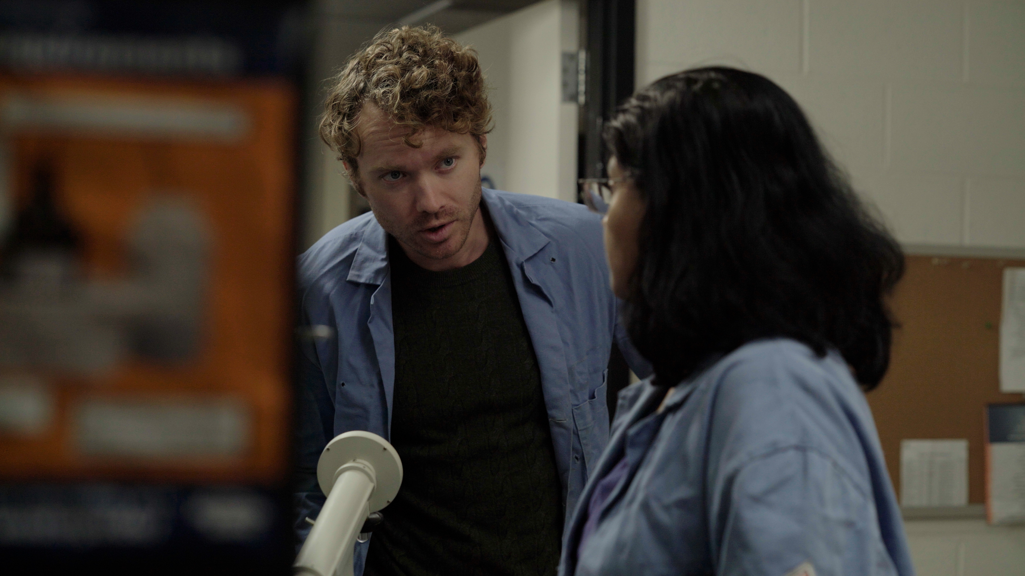
Activities and
Discussions
ncpre

Slide 4
Mistakes and Accountability
2-Minute Challenge
Discuss the following 2MC, which is a real problem encountered by a researcher:
"You have just become a post doc for a lab head who gave you data to analyze that was collected from 50 subjects. However, the research coordinator, who is resigning, told you that the fMRI scans had only been done on 6 of the 50 subjects and that the results did not support the lab head's hypothesis. You felt like you've just been handed a smoking gun and want out of this project immediately. "
Discuss the following questions in your small groups (10 Minutes):
What would you do? What are the consequences of staying/leaving?
Have one person to take notes for sharing with the larger group.

Slide 5
Mistakes and Accountability
2-Minute Challenge - Recap
Share one or two key takeaways from your small group discussion with the whole group (5 Minutes).
As a large group, walk through the 6 questions of the DMF and discuss this scenario (15 Minutes):

Slide 6
Practicing Tools - TRAGEDIES on Display
Take a few minutes with your group to look over Darren’s actions in this scene (where they discover the mistake in his notes) through the lens of career TRAGEDIES.
Identify and describe the TRAGEDIES with your small group (15-20 minutes):
T – Temptation
R – Rationalization
A – Ambition
G – Group & Authority Pressure
E - Entitlement
D – Deception
I – Incrementalism
E – Embarrassment
S – Stupid Systems

Slide 7
Better Science Discussion
In this scene Darren and Meena discover the mistake that led to the errors in the synthesis stem from an issue with Darren’s notes.
Discuss the following questions (10-15 Minutes):
Why do you think Darren did not try to address the discrepant results that Jayna found as a scientific question, but rather assumed that Jayna, and then Harold, and then Meena were doing something wrong?
How common is Darren's approach and why does it happen?

Slide 8
Lab Manual Discussion Questions
Consider how the main conflict between the two labs ultimately stemmed from a single typo in the lab protocols that they discover in this scene.
In small group Discuss the Following (10 Minutes):
Thinking about the various sections in your lab manual, consider how you will articulate how you want mistakes handled in your lab?
How can lab leadership best model how to be transparent about mistakes and reflect that in the lab manual?

