Slide 1
3.4 Facilitator Slides
Goals for Session
Agenda and Activities
Final Reflection
ncpre

Slide 2
3.4 Session Goals
GOALS:
Share the work that you are doing on your own as you go through the course
Reflect on your learning
Practice some of the tools that you were introduced to in the course
Get to know others in your lab/class
STRUCTURE:
Will meet every _ weeks for _ hours
Large and small group discussions
Logbook Activities, Program Reflection, Better Science, and Lab Manual questions can be part of each session

Slide 3
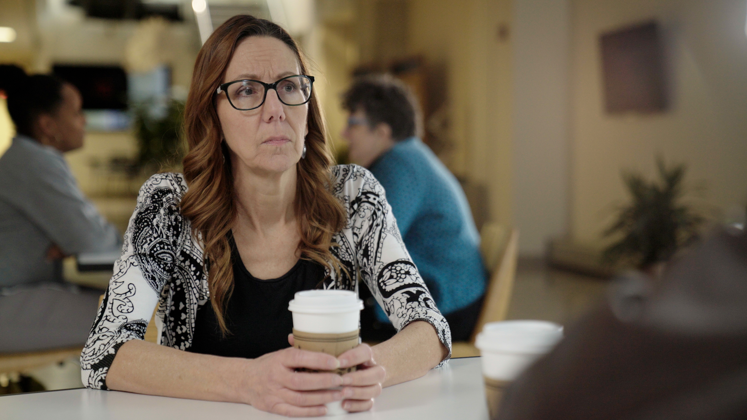
Activities and
Discussions
ncpre

Slide 4
Difficult Conversations
2-Minute Challenge
Discuss the following 2MC, which is a real problem encountered by a researcher:
"Your lab, along with other labs at different institutions, collaborates frequently with a field researcher who periodically sends you data for analysis. Although you have never met this scientist, your name appears on several papers with her because you helped with some sections of the manuscripts. But now you are concerned. This week, you and colleagues at other institutions received an email from a reader pointing out a troubling discrepancy in the data in one of those articles, which was recently published in a top journal. The field researcher, who is on a research trip in Bolivia at the moment, has insisted by email that everything is fine, but you are not so sure. After all, you think, how hard would it be to fabricate results if no one else has access to the full data set? Meanwhile, your colleagues at other institutions --most of whom are tenured, unlike you --do not seem to be in a hurry to address the problem. "
Discuss the following questions in your small groups (10 Minutes):
What would you do?
Have one person to take notes for sharing with the larger group.

Slide 5
Difficult Conversations
2-Minute Challenge - Recap
Share one or two key takeaways from your small group discussion with the whole group (5 Minutes).
As a large group, discuss a few of the salient TRAGEDIES in this scenario (15 Minutes):
T – Temptation
R – Rationalization
A – Ambition
G – Group & Authority Pressure
E - Entitlement
D – Deception
I – Incrementalism
E – Embarrassment
S – Stupid Systems

Slide 6
Practicing Difficult Conversations
Consider an instance where you are collaborating with another lab or with a colleague and you feel the expectations are not clear or have not been met. What can you do to re-set the collaboration and move the project in a constructive direction?
Discuss with your small group (10-15 minutes)
What personal scripts would you use to…
…open the conversation?
…address your concerns?
What would an inter-lab collaboration agreement look like? What expectations should be discussed and/or recorded?

Slide 7
Better Science Discussion
In this scene the Sorenson and Heideberg lab leaders tackle the issues with their flailing collaboration agreement and try and hit the reset button. Consider the role of inter-organizational collaborations in your field during your discussion.
With your small group, discuss the following questions (15-20 Minutes):
Why do you need to collaborate in your work?
Think about collaborations you have participated in. What has worked or not worked?
Are their best practices for initiation a collaboration? Keeping it on track?
What are some red flags?

Slide 8
Lab Manual Discussion Questions
Collaborations are part of the success of any lab or organization. It will help you to share and access resources and information to solve problems and discover knowledge that would be difficult to on your own.
In small group Discuss the Following (10 Minutes):
What information would you include in a lab manual about initiating a collaboration and with keeping it on track throughout its lifespan?
What best practices would you include that you typically don’t see in a manual?

