Slide 1
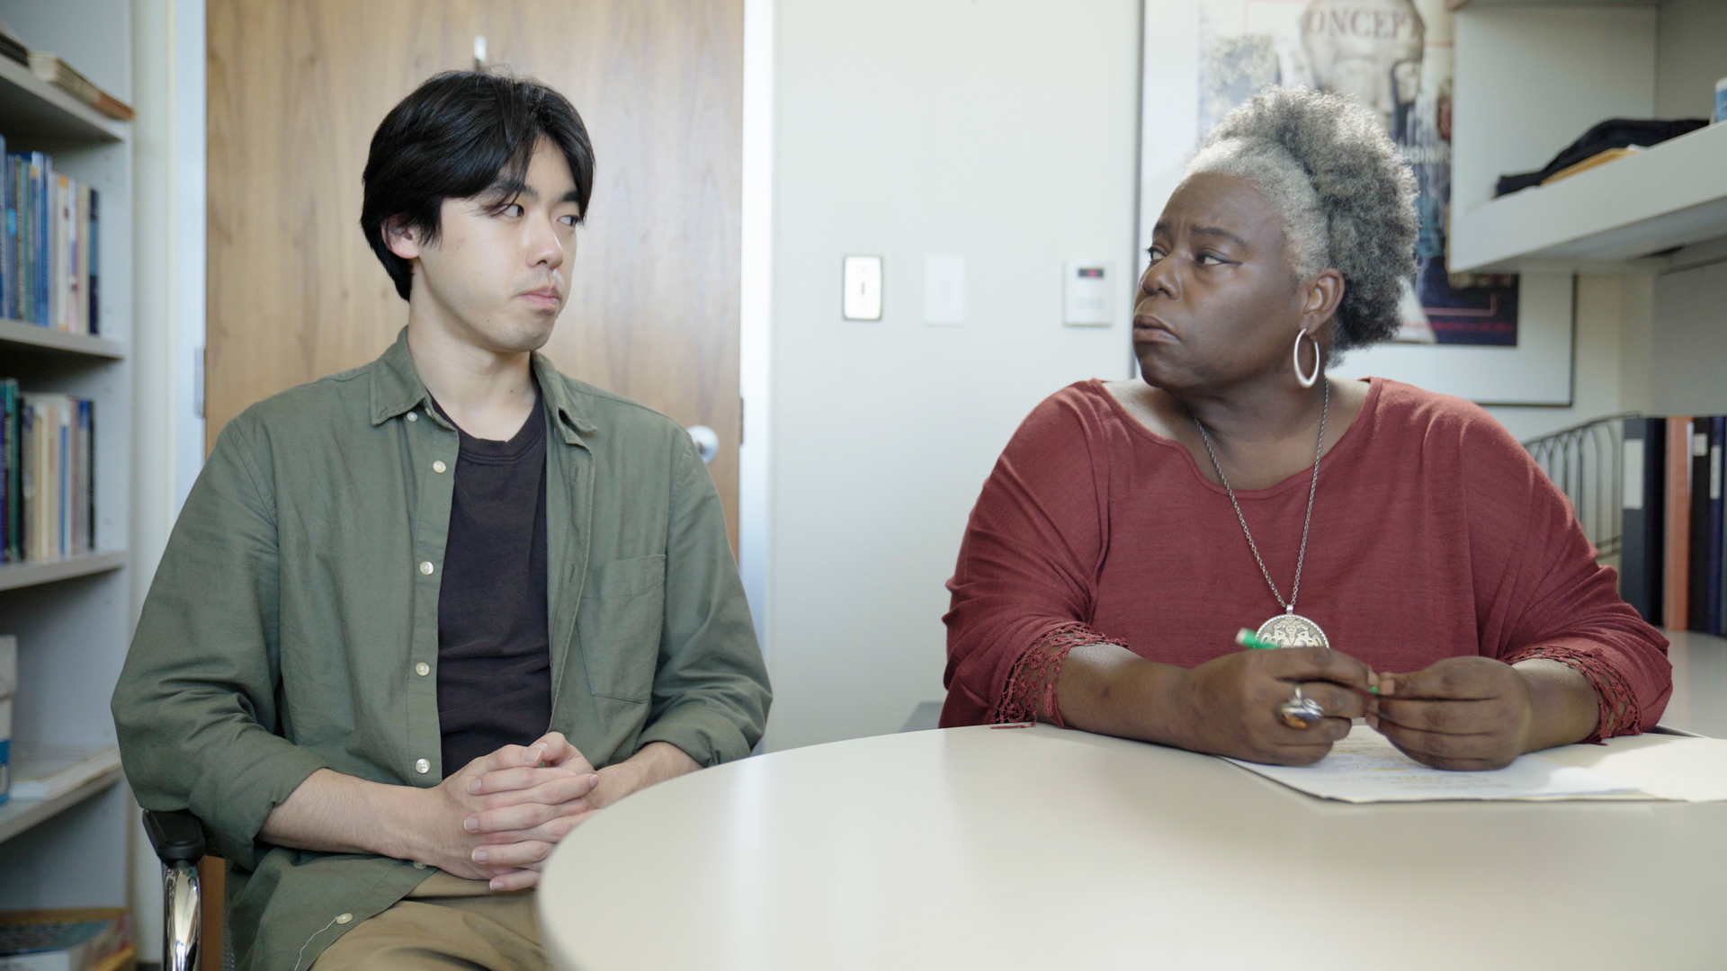
3.5 Facilitator Slides
Goals for Session
Agenda and Activities
Final Reflection
ncpre

Slide 2
3.5 Session Goals
GOALS:
Share the work that you are doing on your own as you go through the course
Reflect on your learning
Practice some of the tools that you were introduced to in the course
Get to know others in your lab/class
STRUCTURE:
Will meet every _ weeks for _ hours
Large and small group discussions
Logbook Activities, Program Reflection, Better Science, and Lab Manual questions can be part of each session

Slide 3
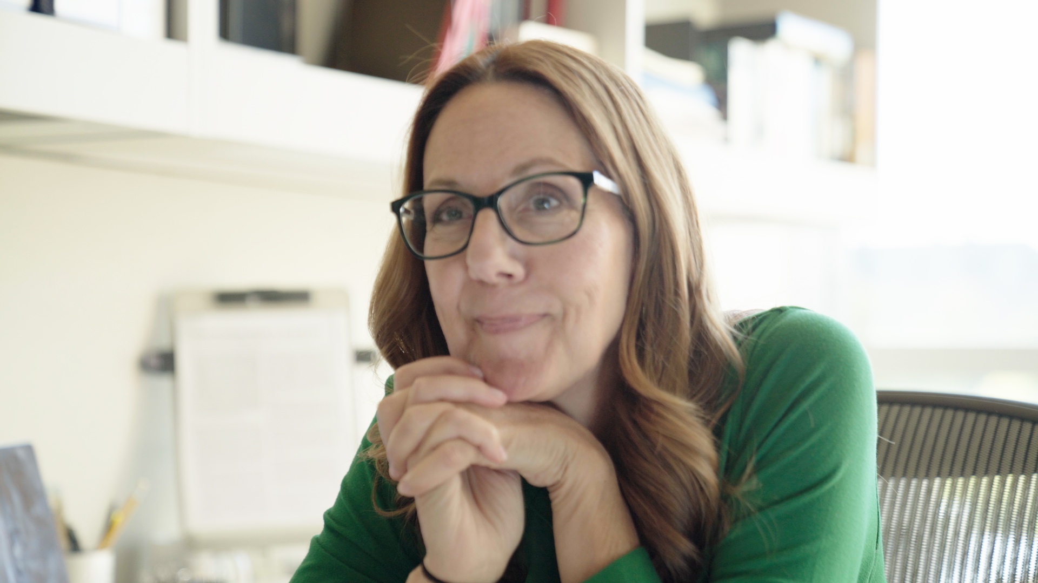
Activities and
Discussions
ncpre

Slide 4
Apologies and Mentoring
Alex is new to the Sorenson lab and finds the structure vastly different than what he experienced in his old lab. Take a moment and think about your experiences and understanding of mentoring.
Discuss the following questions in your small groups (10 Minutes):
Have any of your group had very different experiences in lab structure and culture, similar to Alex in this scene?
Brainstorm some key phrases that define what good mentoring looks like to you
What do those key phrases look like in practice?
Have one person to take notes for sharing with the larger group.

Slide 5
Apologies and Mentoring
Share one or two key takeaways from your small group discussion on good mentorship with the whole group (10-15 Minutes).
Key Phrases – Good Mentoring
Good Mentoring in Practice

Slide 6
Apologies
*If needed, please rewatch the video on Apolgies before proceeding.
Consider the 4 Rs of an apology with your group (10-15 Minutes):
What you think Darren needs to say to Jayna and
Meena about his assumptions about the source
of the discrepancy in the data?
What he needs to say to Drs Heidberg and Sorenson
about the collaboration?

Slide 7
Practicing Difficult Conversations
Consider an instance where you are collaborating with another lab or with a colleague and you feel the expectations are not clear or have not been met. What can you do to re-set the collaboration and move the project in a constructive direction?
Discuss with your small group (10-15 minutes)
What personal scripts would you use to…
…open the conversation?
…address your concerns?
What would an inter-lab collaboration agreement look like? What expectations should be discussed and/or recorded?

Slide 8
Better Science Discussion
In this scene the Sorenson and Heideberg lab leaders tackle the issues with their flailing collaboration agreement and try and hit the reset button. Consider the role of inter-organizational collaborations in your field during your discussion.
With your small group, discuss the following questions (15-20 Minutes):
Why do you need to collaborate in your work?
Think about collaborations you have participated in. What has worked or not worked?
Are their best practices for initiation a collaboration? Keeping it on track?
What are some red flags?

Slide 9
Lab Manual Discussion Questions
Collaborations are part of the success of any lab or organization. It will help you to share and access resources and information to solve problems and discover knowledge that would be difficult to on your own.
In small group Discuss the Following (10 Minutes):
What information would you include in a lab manual about initiating a collaboration and with keeping it on track throughout its lifespan?
What best practices would you include that you typically don’t see in a manual?

