Slide 1
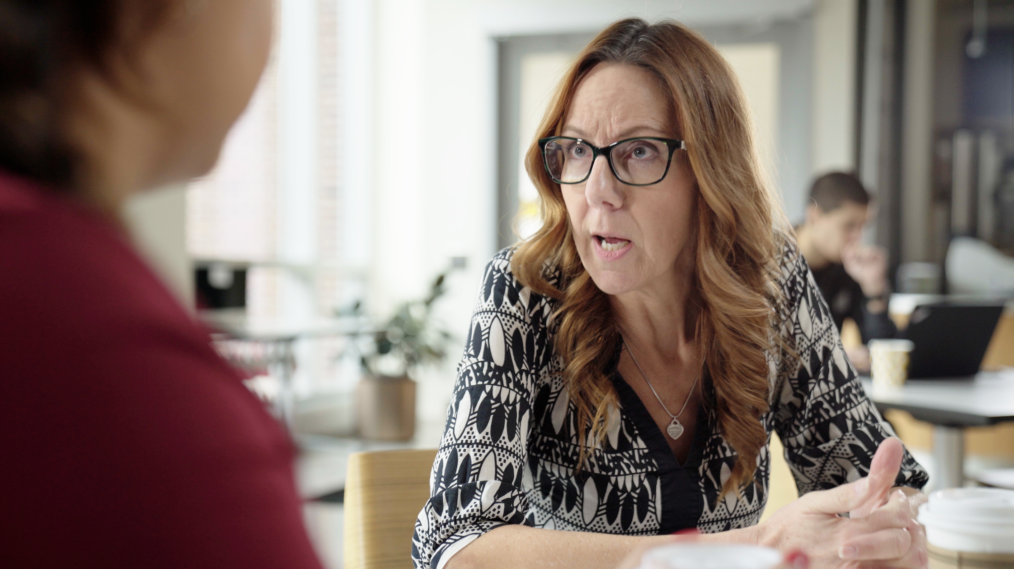






3.6 Facilitator Slides
Goals for Session
Agenda and Activities
Final Reflection
ncpre

Slide 2

3.6 Session Goals
GOALS:
Share the work that you are doing on your own as you go through the course
Reflect on your learning
Practice some of the tools that you were introduced to in the course
        Get to know others in your lab/class
STRUCTURE:
Will meet every _ weeks for _ hours
Large and small group discussions
        Logbook Activities, Program Reflection, Better Science, and Lab Manual questions can be part of each session

Slide 3

Activities and
Discussions
ncpre

Slide 4




Mentoring Conversations
After acknowledging the ramifications of her hands-off, Socratic approach, Sorenson is reconsidering how she matches mentoring with individual needs. The responsibility is not all the mentor’s, though. When you own your own career, you have responsibility for your values, goals, and needs, and finding effective ways to communicate them. Review the people you included in your mentoring map (see logbook section for episode 2.11).
Discuss the following questions in your small groups (10 Minutes):
Would different types of mentoring be more effective (one-on-one, group/collective based, peer based, situational, networked, etc.) from different mentors?
Would they be more effective for different needs?
Have one person to take notes for sharing with the larger group.

Slide 5
Mentoring Conversations - Recap
Share one or two key takeaways from your small group discussion with the whole group (5 Minutes).

Slide 6




Personal Scripts for Mentoring Conversations
Leverage the work you did on your mentoring philosophy in Episode 3.5 alongside the outline below to create an approach to what you seek from a mentoring relationship.
With your groups, write conversation openers as the (1) mentor and (2) mentee for the following topics (10-15 Minutes):
Primary Goals of the mentor/mentee relationship
Successful Working Relationship
Method of Communication
Setting Expectations
Discussing Issues that arise

Slide 7
Personal Scripts for Mentoring Conversations
With your groups, share your conversation openers
(5-10 minutes)
Primary Goals of the mentor/mentee relationship
Successful Working Relationship
Method of Communication
Setting Expectations
Discussing Issues that arise

Slide 8


Lab Manual Discussion Questions
You were asked in this section to turn your attention to what you would most want to pay attention to over the next year and to create an Individual Development Plan (IDP) for identifying your personal and professional goals.
In small group Discuss the Following (10 Minutes):
Discuss and create a lab manual section which details the need for IDPs.
How often will you require those to be reviewed and revised? How will the lab support individuals efforts to achieve their IDPs? Specify the language and add it to the lab manual.

