Slide 1
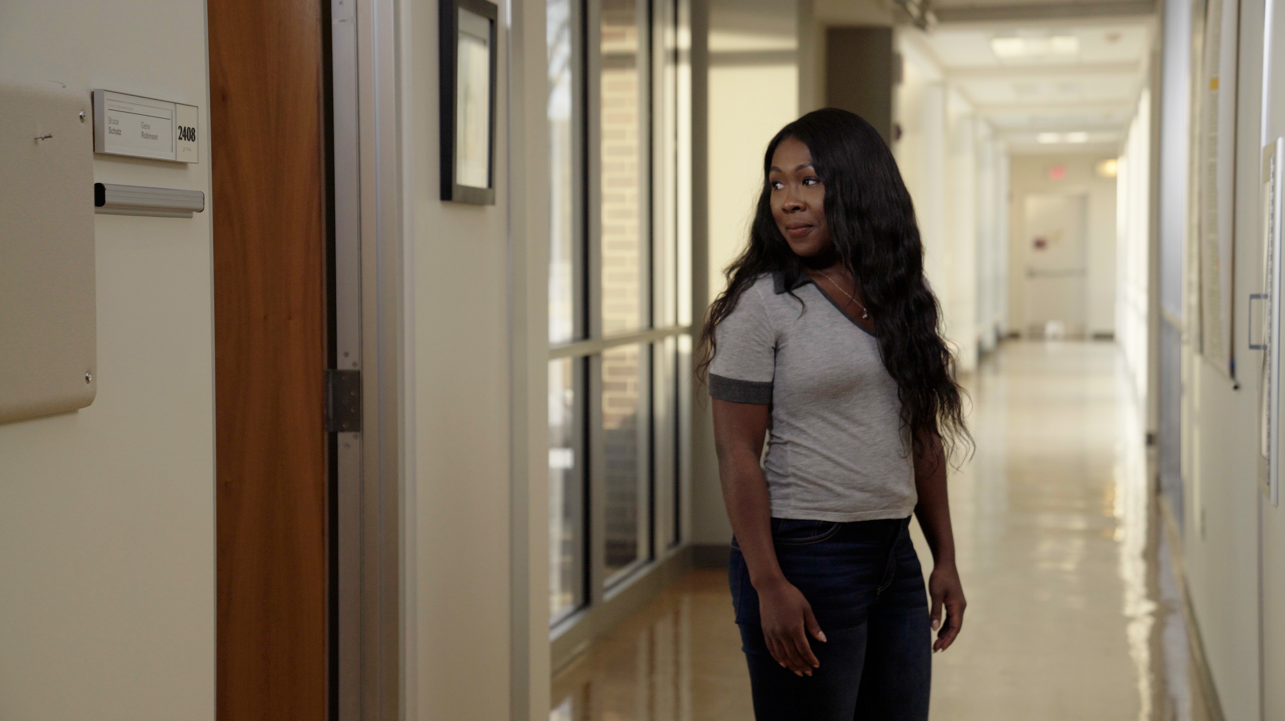






3.7 Facilitator Slides
Goals for Session
Agenda and Activities
Final Reflection
ncpre

Slide 2

3.7 Session Goals
GOALS:
Share the work that you are doing on your own as you go through the course
Reflect on your learning
Practice some of the tools that you were introduced to in the course
        Get to know others in your lab/class
STRUCTURE:
Will meet every _ weeks for _ hours
Large and small group discussions
        Logbook Activities, Program Reflection, Better Science, and Lab Manual questions can be part of each session

Slide 3
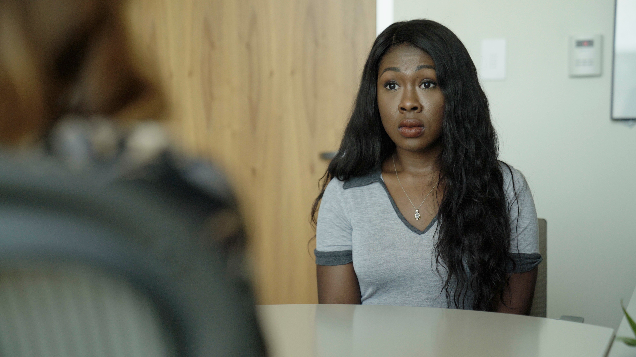
Activities and
Discussions
ncpre

Slide 4



Owning Your Career
Think about the events in the episodes that you have watched. Looking back at the events of the collaboration between the two labs, what might have been changed and improved how these events unfolded if they had access to this curriculum?
Discuss the following questions in your small groups (10 Minutes):
Pick one character from each lab. Describe and write down moments where having professional development skills would have been helpful
What do each of you most want to pay attention to over the next year, and what supports will you each need to be successful in those areas? Share, if appropriate with your group members
Have one person to take notes for sharing with the larger group.

Slide 5
Owning Your Career
Large Group Discussion
Share one or two key takeaways from your small group discussion with the whole group (10 Minutes).
Which characters did you select? What would have helped them?
Focusing on what you want to change, discuss with the large group (5-10 Minutes):
Are supports readily available for you in the lab to make changes this year?
What can/will you do if not?

Slide 6


IDP - Individual Development Plan
As part of the logbook reflections, you were asked to reflect upon what you have learned and prepare an Individual Development Plan or IDP. This is to identify personal and professional goals over the next academic semester or year that you wish to achieve and to identify steps, resources, and obstacles that affect them.
Discuss with your small group (10-15 minutes)
If you are comfortable, share some of the personal/professional goals you selected in your IDP.
Why did you select the goals that you did?
What are resources/skills that you will need to achieve them that you…
  …already posses?
  …need to develop further?

Slide 7


Lab Manual Discussion Questions
You were asked in this section to turn your attention to what you would most want to pay attention to over the next year and to create an Individual Development Plan (IDP) for identifying your personal and professional goals.
In small group Discuss the Following (10 Minutes):
Discuss and create a lab manual section which details the need for IDPs.
How often will you require those to be reviewed and revised? How will the lab support individuals efforts to achieve their IDPs? Specify the language and add it to the lab manual.

